Slide 1
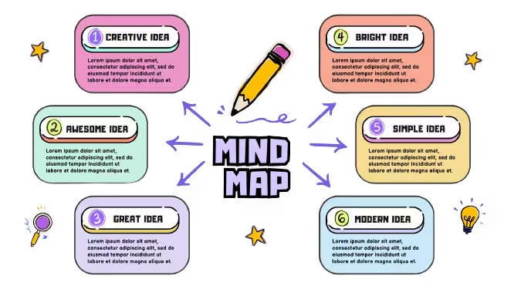
Mind Maps
Mind maps are a great way to organise important information. There are many mind map examples available on the internet but it’s even better to create your own as the act of re-reading and summarising your notes will help embed the knowledge into your long-term memory.

Slide 2
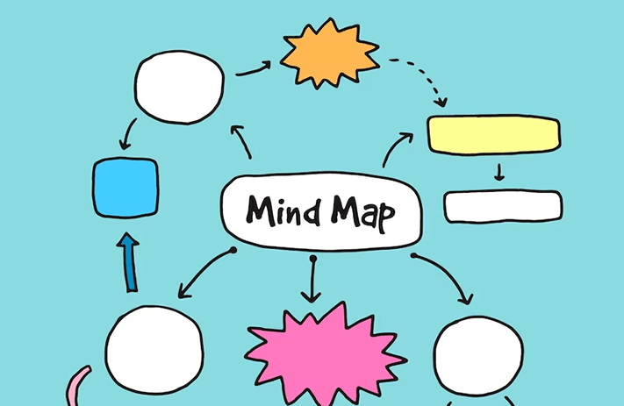

Slide 3
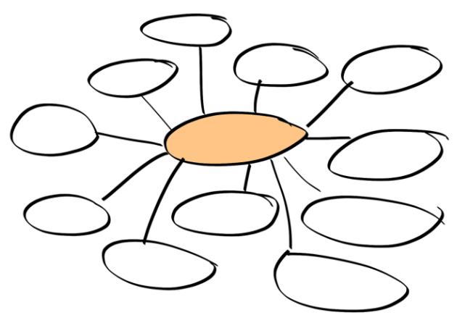

Slide 4
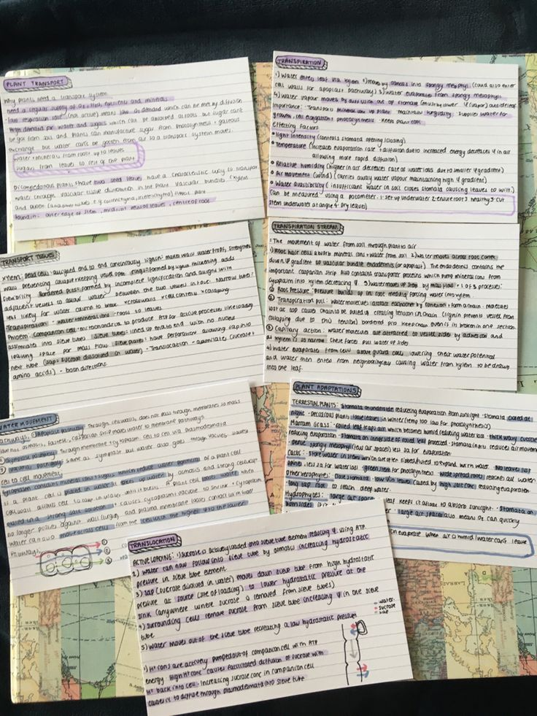
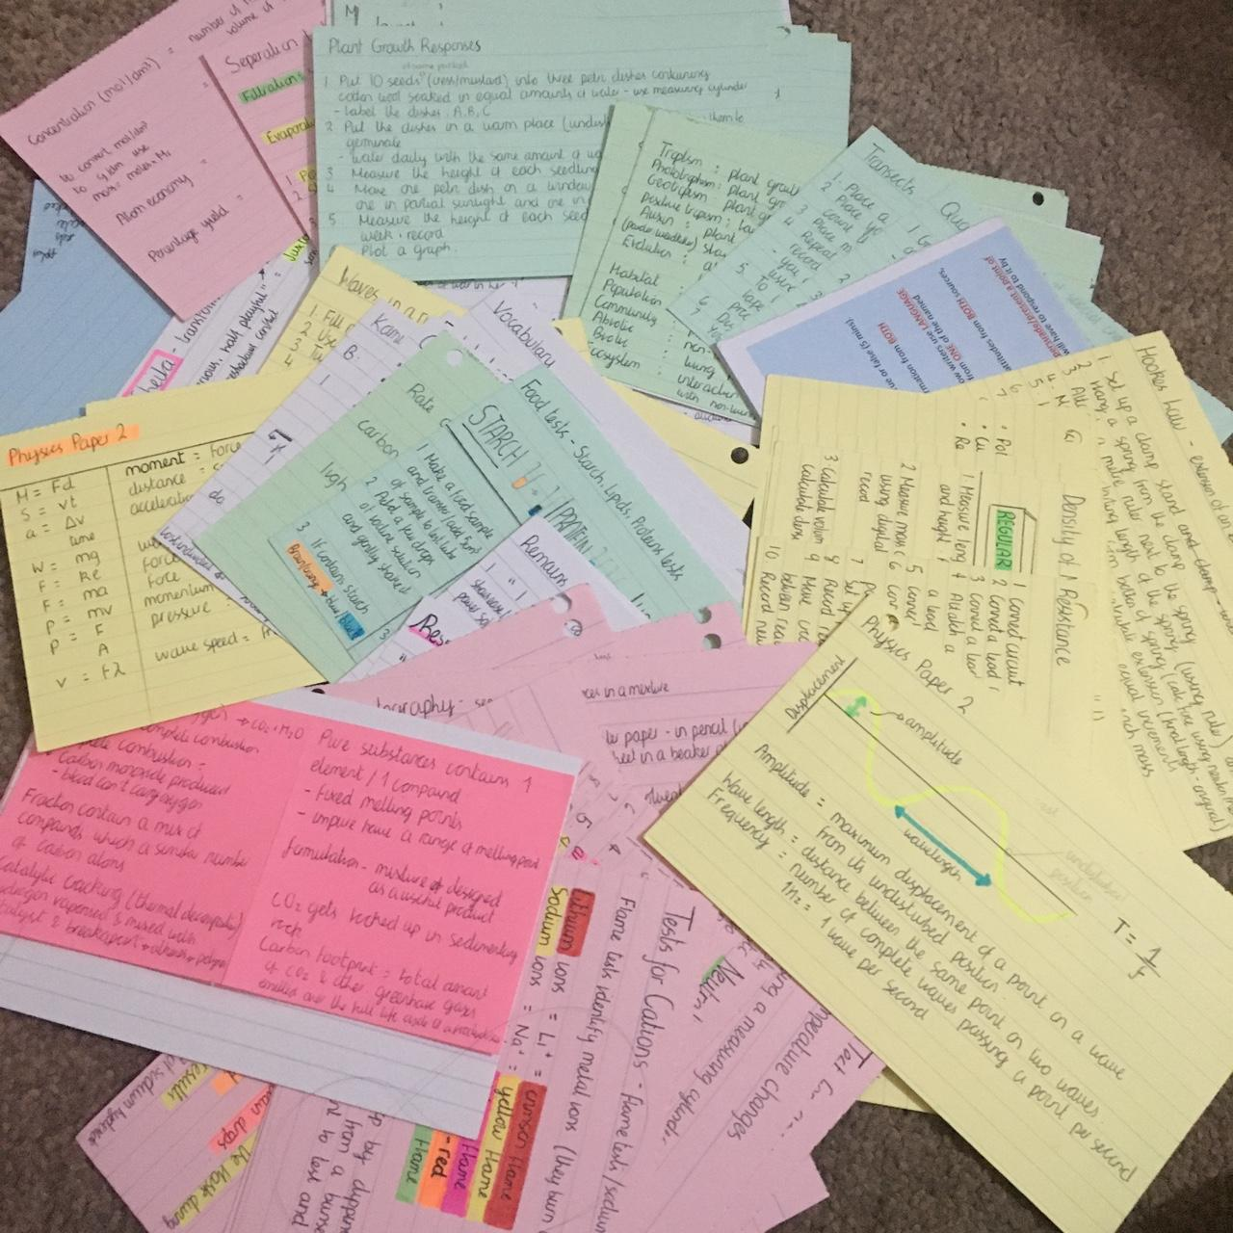

Slide 5
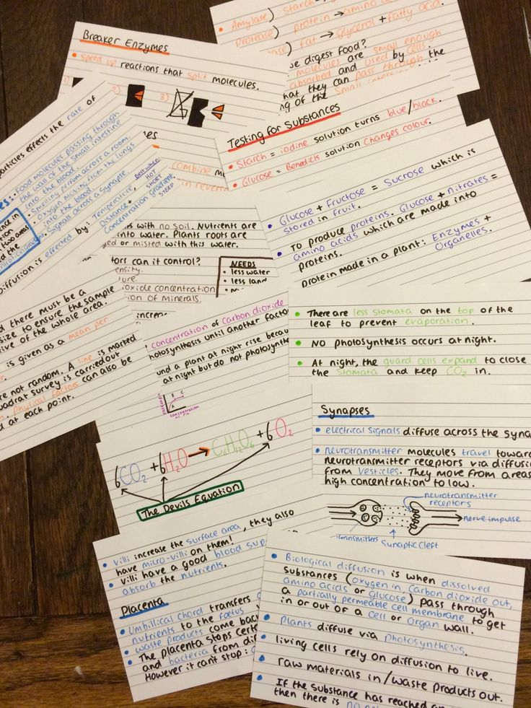
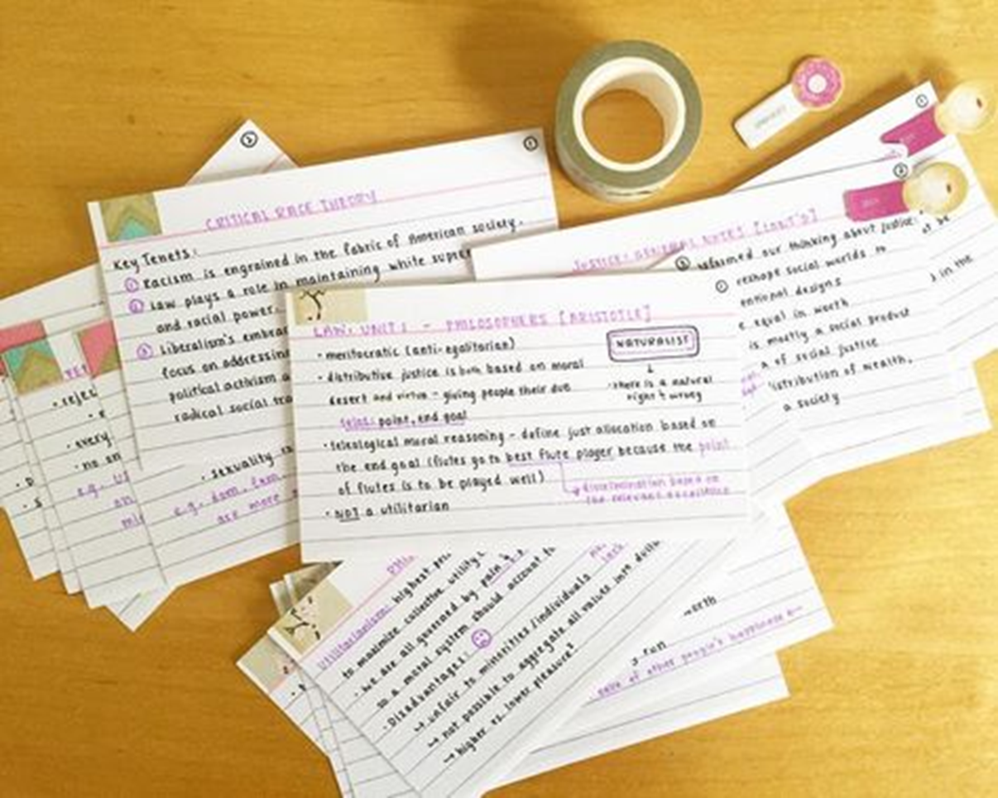
Flash Cards
One of the best uses of flash cards is to self-quiz but you can even get a friend or family member to quiz you on different topics. A lot of ready made flash cards come with self-quizzing questions on the front and the answers on the back, these are also easy to create yourself. An important aspect of self-quizzing yourself with flash cards is to change the order of the questions each time you do it. This means your brain won’t just learn the answers like learning the words to a song you hear regularly, it will need to think about connecting the correct answer to the question.

Slide 6
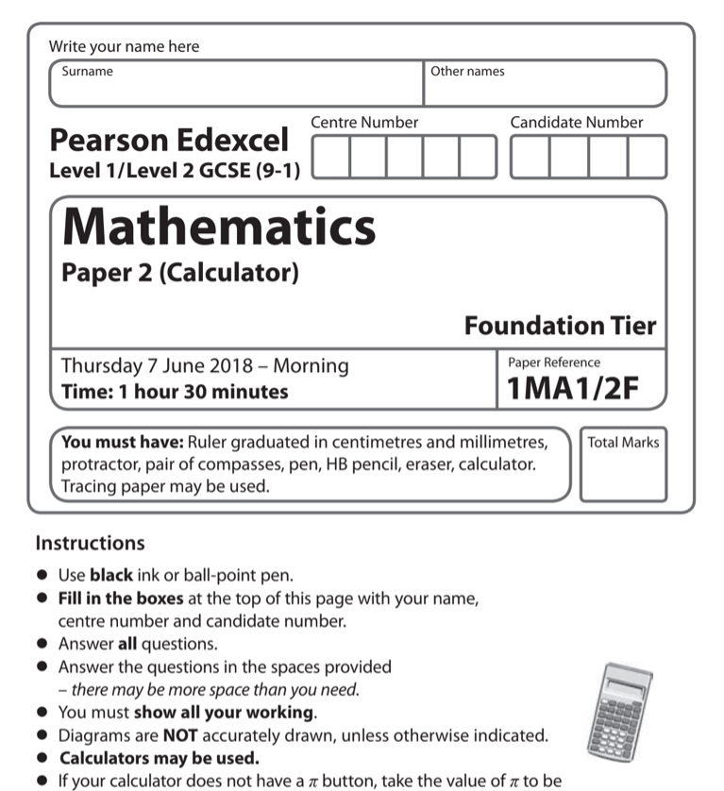
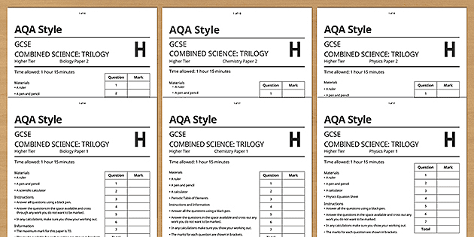
Past papers, questions and mark schemes
Try to get as many past exams as possible and the mark schemes to go with them. If you are finding the mark scheme hard to follow, ask a teacher to explain how it works. Some exam boards produce “student friendly” mark schemes that are easier to follow. It can also be useful to look at examiners’ reports for past examinations, as they can highlight common errors and also help explain what was done well and how. But just having lots of past papers is not enough. It’s important that they are used well to prepare for the actual day of the exam.

