Slide 1

The Power of Testing
Low-stakes tests and quizzes as a learning strategy

Slide 2
Retrieval Practice (the testing effect)
Practice testing forces you to search your memory to find and retrieve the information.
This retrieval creates a pathway you can use to access that knowledge more easily.
Testing as a learning strategy is not the same as assessment of learning.

Slide 3
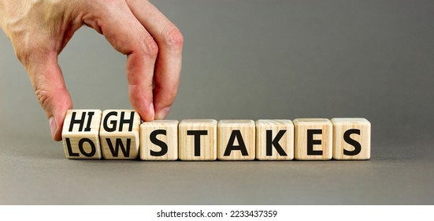
Keep it low-stakes!
It’s better to reframe ‘tests’ as ‘quizzes’
High stakes tests can increase student anxiety and impair performance

Slide 4

Don’t delay!
Research suggests that a short quiz as soon as possible after the lesson (ideally the same day after school) is more likely to reinforce the material.
Memory is strengthened further if the same material is revisited a few days later and the quiz is repeated.

Slide 5
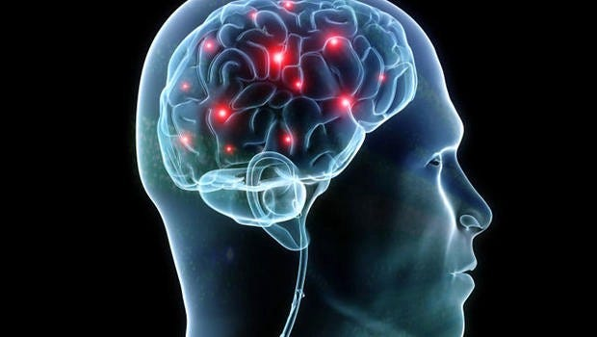
Tests enhance brain function and mental health
Regular low-stakes quizzes strengthen neural pathways and makes it easier for us to retrieve information from long-term memory
Research shows that quizzes can slow down cognitive decline.

Slide 6

Quiz format is less important than no quiz at all
Any type of quizzing that encourages retrieval and thinking should help students learn.
Students could write out what they know on a topic (Brain Dump), complete multiple-choice questions, and use Flashcards etc.
For increasing general learning and memory it doesn’t seem to matter what method is used.

Slide 7
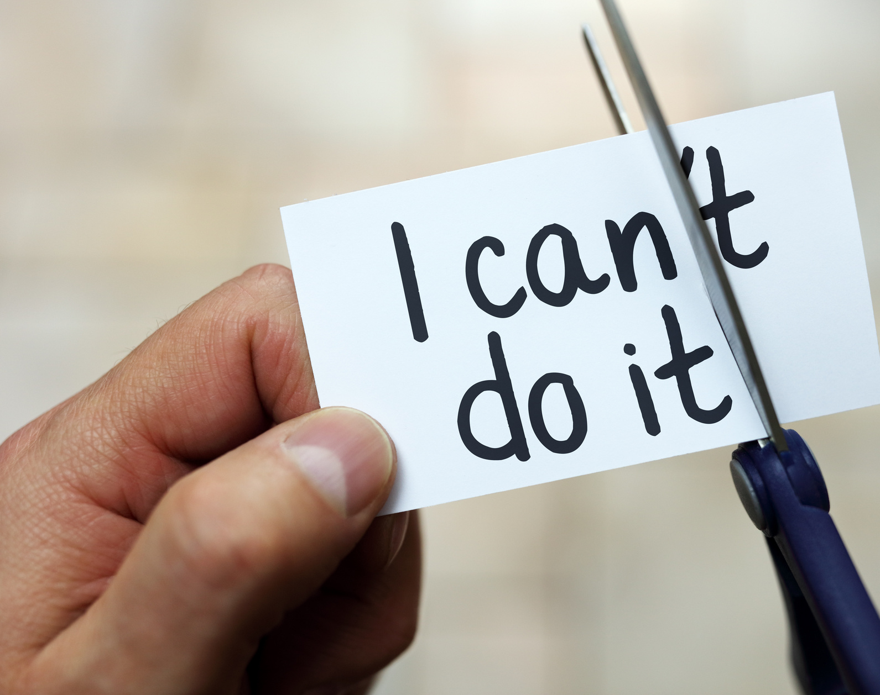
More confidence, less nerves
A recent study on the power of the testing effect found that
  92% of students said it helped them learn
  72% felt it had made them less nervous about their upcoming exams.

Slide 8
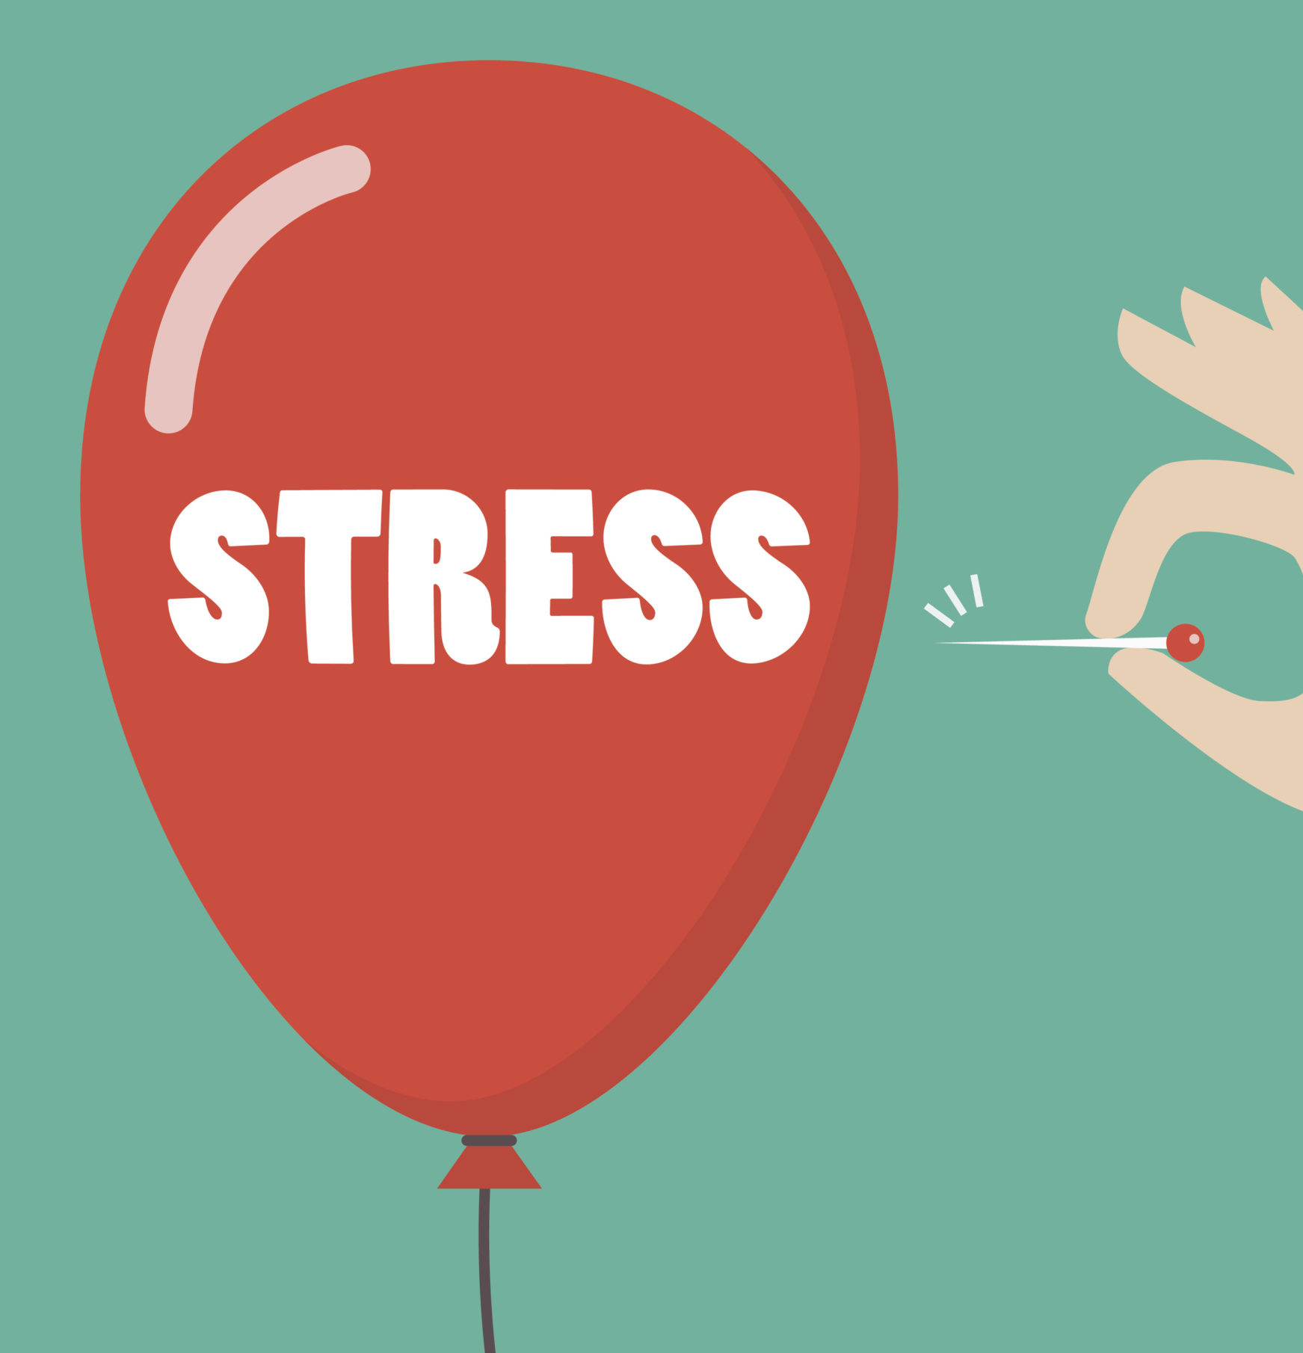
Enhanced memory at times of stress
Too much stress can reduce memory and hinder focus.
Research has shown that “participants who learned just by restudying demonstrated the typical stress-related memory impairment, whereas those who learned by retrieval practice were immune to the harmful effects of stress”.
Not only does testing yourself improve your memory, the effect is magnified during times of anxiety.

Slide 9
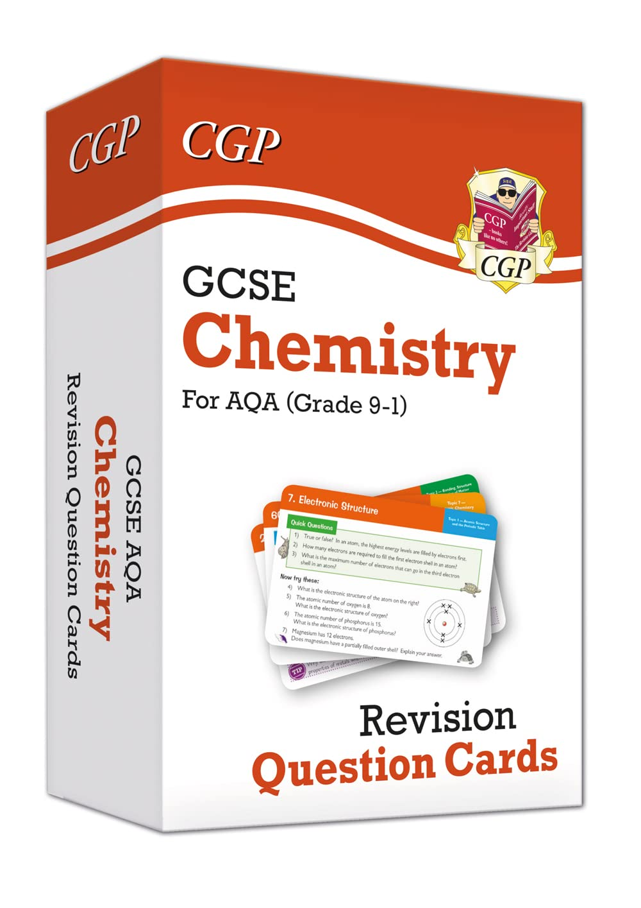
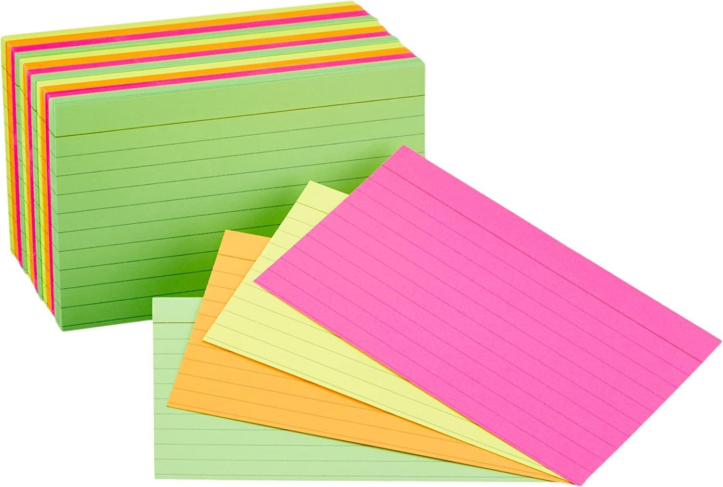
‘Memory is the residue of thought’
‘We remember what we think about.’ (Willingham, 2012)

Slide 10
Keyword:
Use the term correctly in a sentence:
Create a question where the keyword is the answer.
In your own words write a definition:
Draw or find a picture to illustrate this keyword:
What other words Are connected to the keyword?
Not yet!
Self Assess your understanding of this keyword:
Almost!
Got it!

