Slide 1
Supporting Academic Challenge at Home
What do we mean by academic challenge and being 'more able'?
The DfE and Ofsted define the more able in terms of those whose progress significantly exceeds age related expectations.
The National Association for Able Children in Education describe, 'exceptionally able pupils are those who have the capacity to achieve or perform at the very highest levels'

Slide 2

The biggest contribution a parent can make to their child’s education is to be interested and appreciate what they are doing, know what they are interested in, and support them in what they do.
This does not mean you have to be an expert in any of the school subjects! Nor does it mean being ‘on their case’ all the time.
So, where does the balance lie in supporting your child’s independent learning, and how can parents extend academic challenge at home?
Developing young people’s language
Extending their knowledge of the world
Encouraging discussion
Developing a range of skills and a balanced perspective
Praising and valuing effort and persistence, not just achievement
Complement what is done at school, rather than replicating it
Supporting social and emotional needs
Applying learning
All students need repeated learning, but to stretch and challenge young people at home parents can support by helping students to apply their learning in a different context or extend their learning: going sideways rather than upwards.
This will mean students don’t spend time replicating and consolidating knowledge that is already secure, and instead challenge them to think more deeply and embed their learning.

Slide 3
Understanding Academic Challenge: A Practical Guide
Developing language:
Read with your children, even if they are already good readers.
Puzzles, crosswords, logic games, word games, card games, board games all help to develop thinking skills and social interaction. Try learning a new language together
Extending knowledge of the world and encouraging discussion, e.g. Discuss the news, introduce an interesting and new fact or topic of the week.
Give children a broad range of experiences e.g. visiting exhibitions, listening to music, eating different food
Developing a range of skills and a balanced perspective: Do not always focus on your child’s obvious skills – encourage them to sample new activities
Praise and value effort and persistence, not just achievement
It is important to complement what is done at school, not simply replicate it
Social and emotional needs:
All children, including the more able, need to develop self-esteem and confidence to be given praise and encouragement. Children need to know that parents are proud of who they are and not just what they achieve. Their ability should not become the centre of the relationship between parent and child
More able children can sometimes be self-absorbed, and may need to be encouraged by parents to appreciate and listen to the views pf others and learn to interact with others
Listening to your child: Responding is one thing, but listening is vitally important if parents and children are to learn from one another – that means children listening as well as parents!
Older children/adolescents needs: This age group needs a balance of challenge (and chivvying!), support, trust, space and freedom to develop their own individuality and direction.
Challenges:
They may be subject to negative views of academic success or ‘not cool to be bright’ syndrome
Apathy and teenage moods!

Slide 4
Adding depth to revision: Critical Thinking
There are simple and practical ways parents can support students in developing their critical thinking skills beyond the classroom, such as: asking them challenging questions, encouraging them to be more analytical and ask their own questions, ask them to teach you a key learning point, encourage them to use dictionaries and thesauruses to enrich their language, challenge them to produce revision/responses in ways other than writing, and many more.
In conclusion, adopting a methodical approach to academic aspirations involves setting clear goals, breaking them down into manageable tasks, confronting challenges with a problem-solving mindset, exploring diverse disciplines, learning from setbacks, fostering a positive environment, nurturing confidence, staying inquisitive, and exhibiting tenacity.
Analysing
Evaluating
Creating
Problem-solving
Independent Enquiry

Slide 5
Time to explore!
Guidance on Critical Thinking
'Beyond the curriculum' activity ideas
Family 'away days'
Supporting and encouraging good study skills
Parent questions

Slide 6


Slide 7


Slide 8


Slide 9
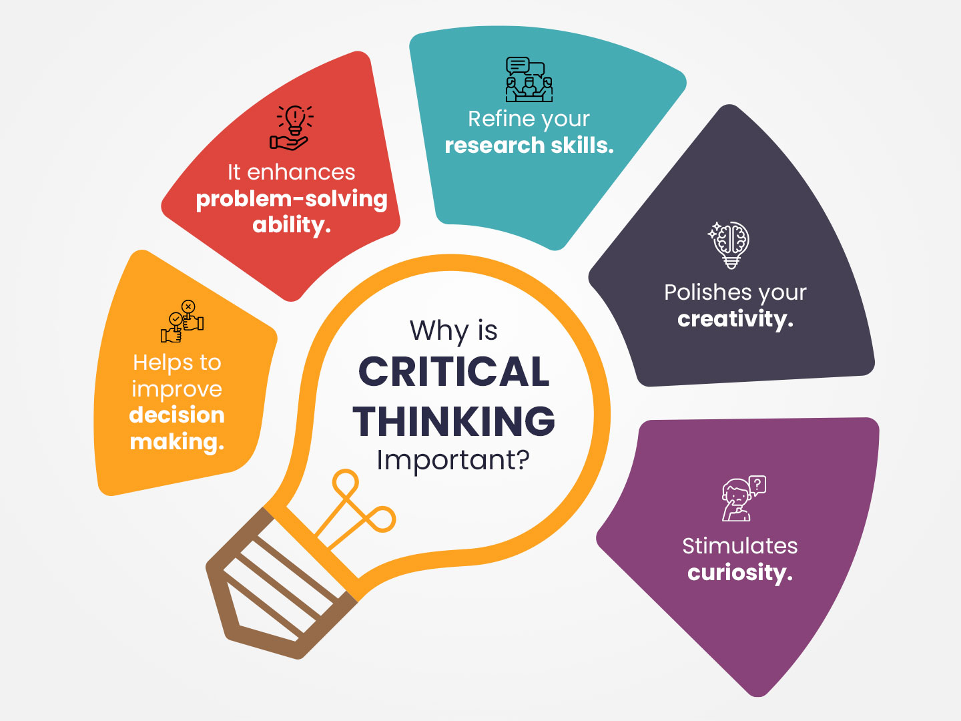

Slide 10
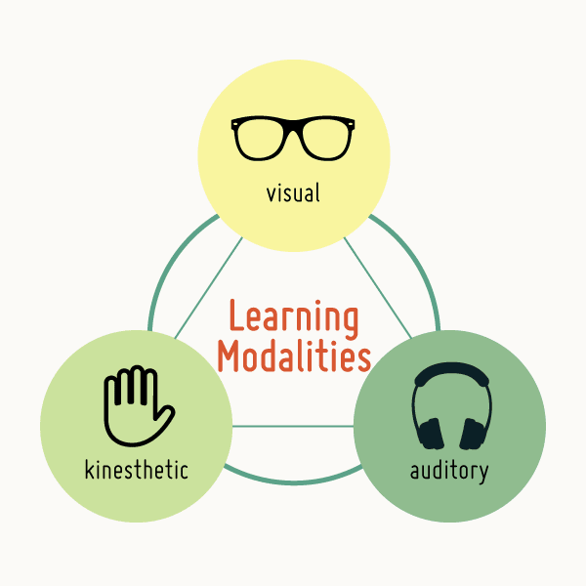

Slide 11


