Slide 1
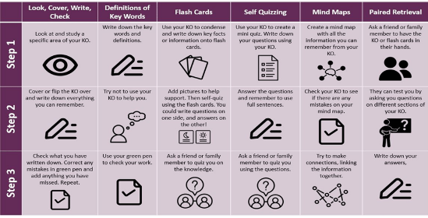
Making better use of your knowledge organiser

