Slide 1
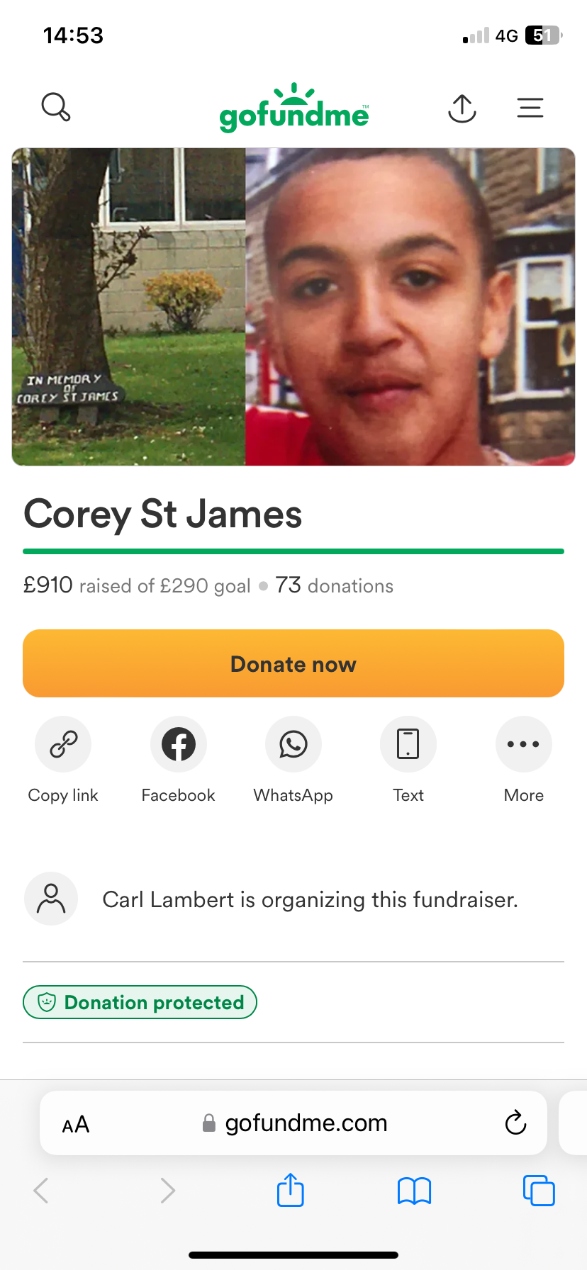
Corey St James
Memorial Bench
1989-2004

Slide 2
Memorial Bench
My name is Mrs Wentworth, some of you may know me from your IT lessons. I have been at the school since 2000, as a trainee teacher to start with. I then started full time in 2002 and have been here for my whole teaching career.
In my first year of teaching I had a year 10 GCSE ICT class. In that class was a student called Corey St James. He had been a student here since Y7, lived in Buxton and had other siblings in the school.
Corey was a ‘larger than life’ character, always had a smile on his face and was very popular with lots of friends.

Slide 3
Memorial Bench
Sadly, in the Easter holidays of Year 10, Corey was tragically killed after being hit by a vehicle whilst out riding with friends.
As a tribute to Corey, his best friends planted a tree (a thin stick at the time) in the main quad behind reception, it is a cherry tree.
Twenty years later, it has grown in to a wonderful mature tree that is full of beautiful blossom every spring, you may have noticed it over the last week. It always reminds me of him, every time it flowers.

Slide 4
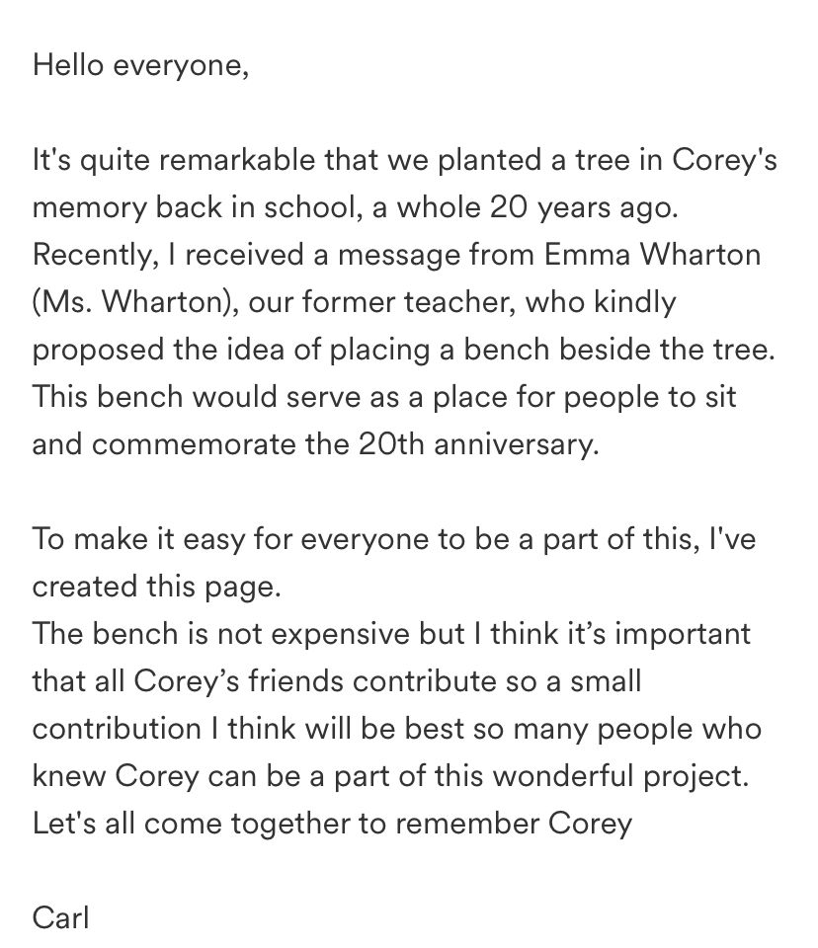
Memorial Bench
Before Christmas 2023, I contacted his best friend Carl with an idea to set up a “Go fund me” page to raise money to make a bench that would go around the tree to commemorate the twentieth anniversary of the sad passing of such a young student.
It raised over £910, and the bench has been put around the tree in memory of Corey this Easter.
There is also a small plaque in the lower atrium that his friends made him (opposite the HUB)

Slide 5
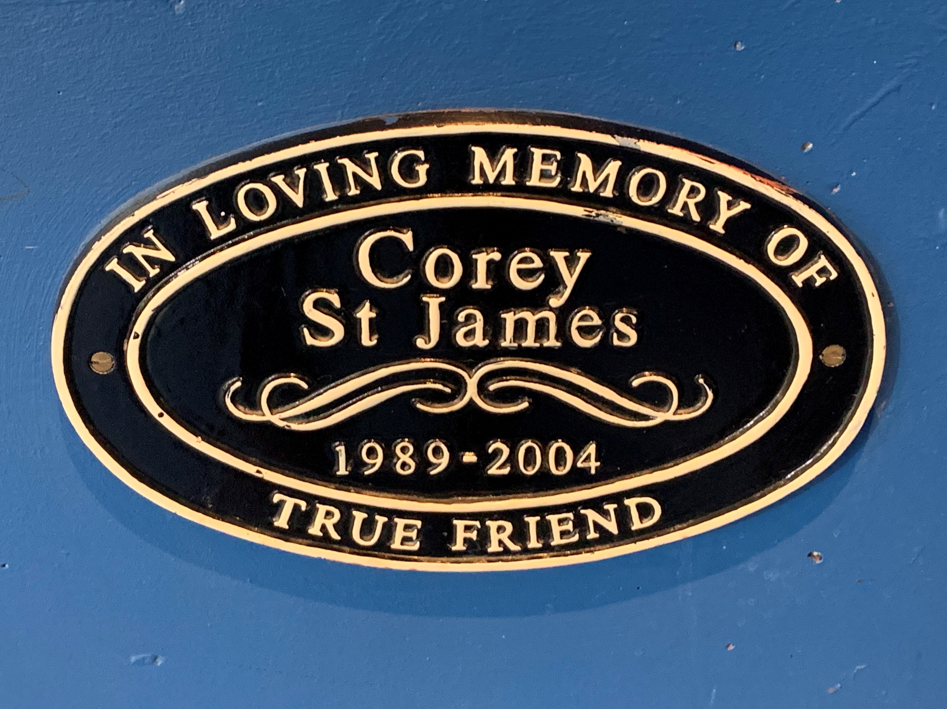

Slide 6
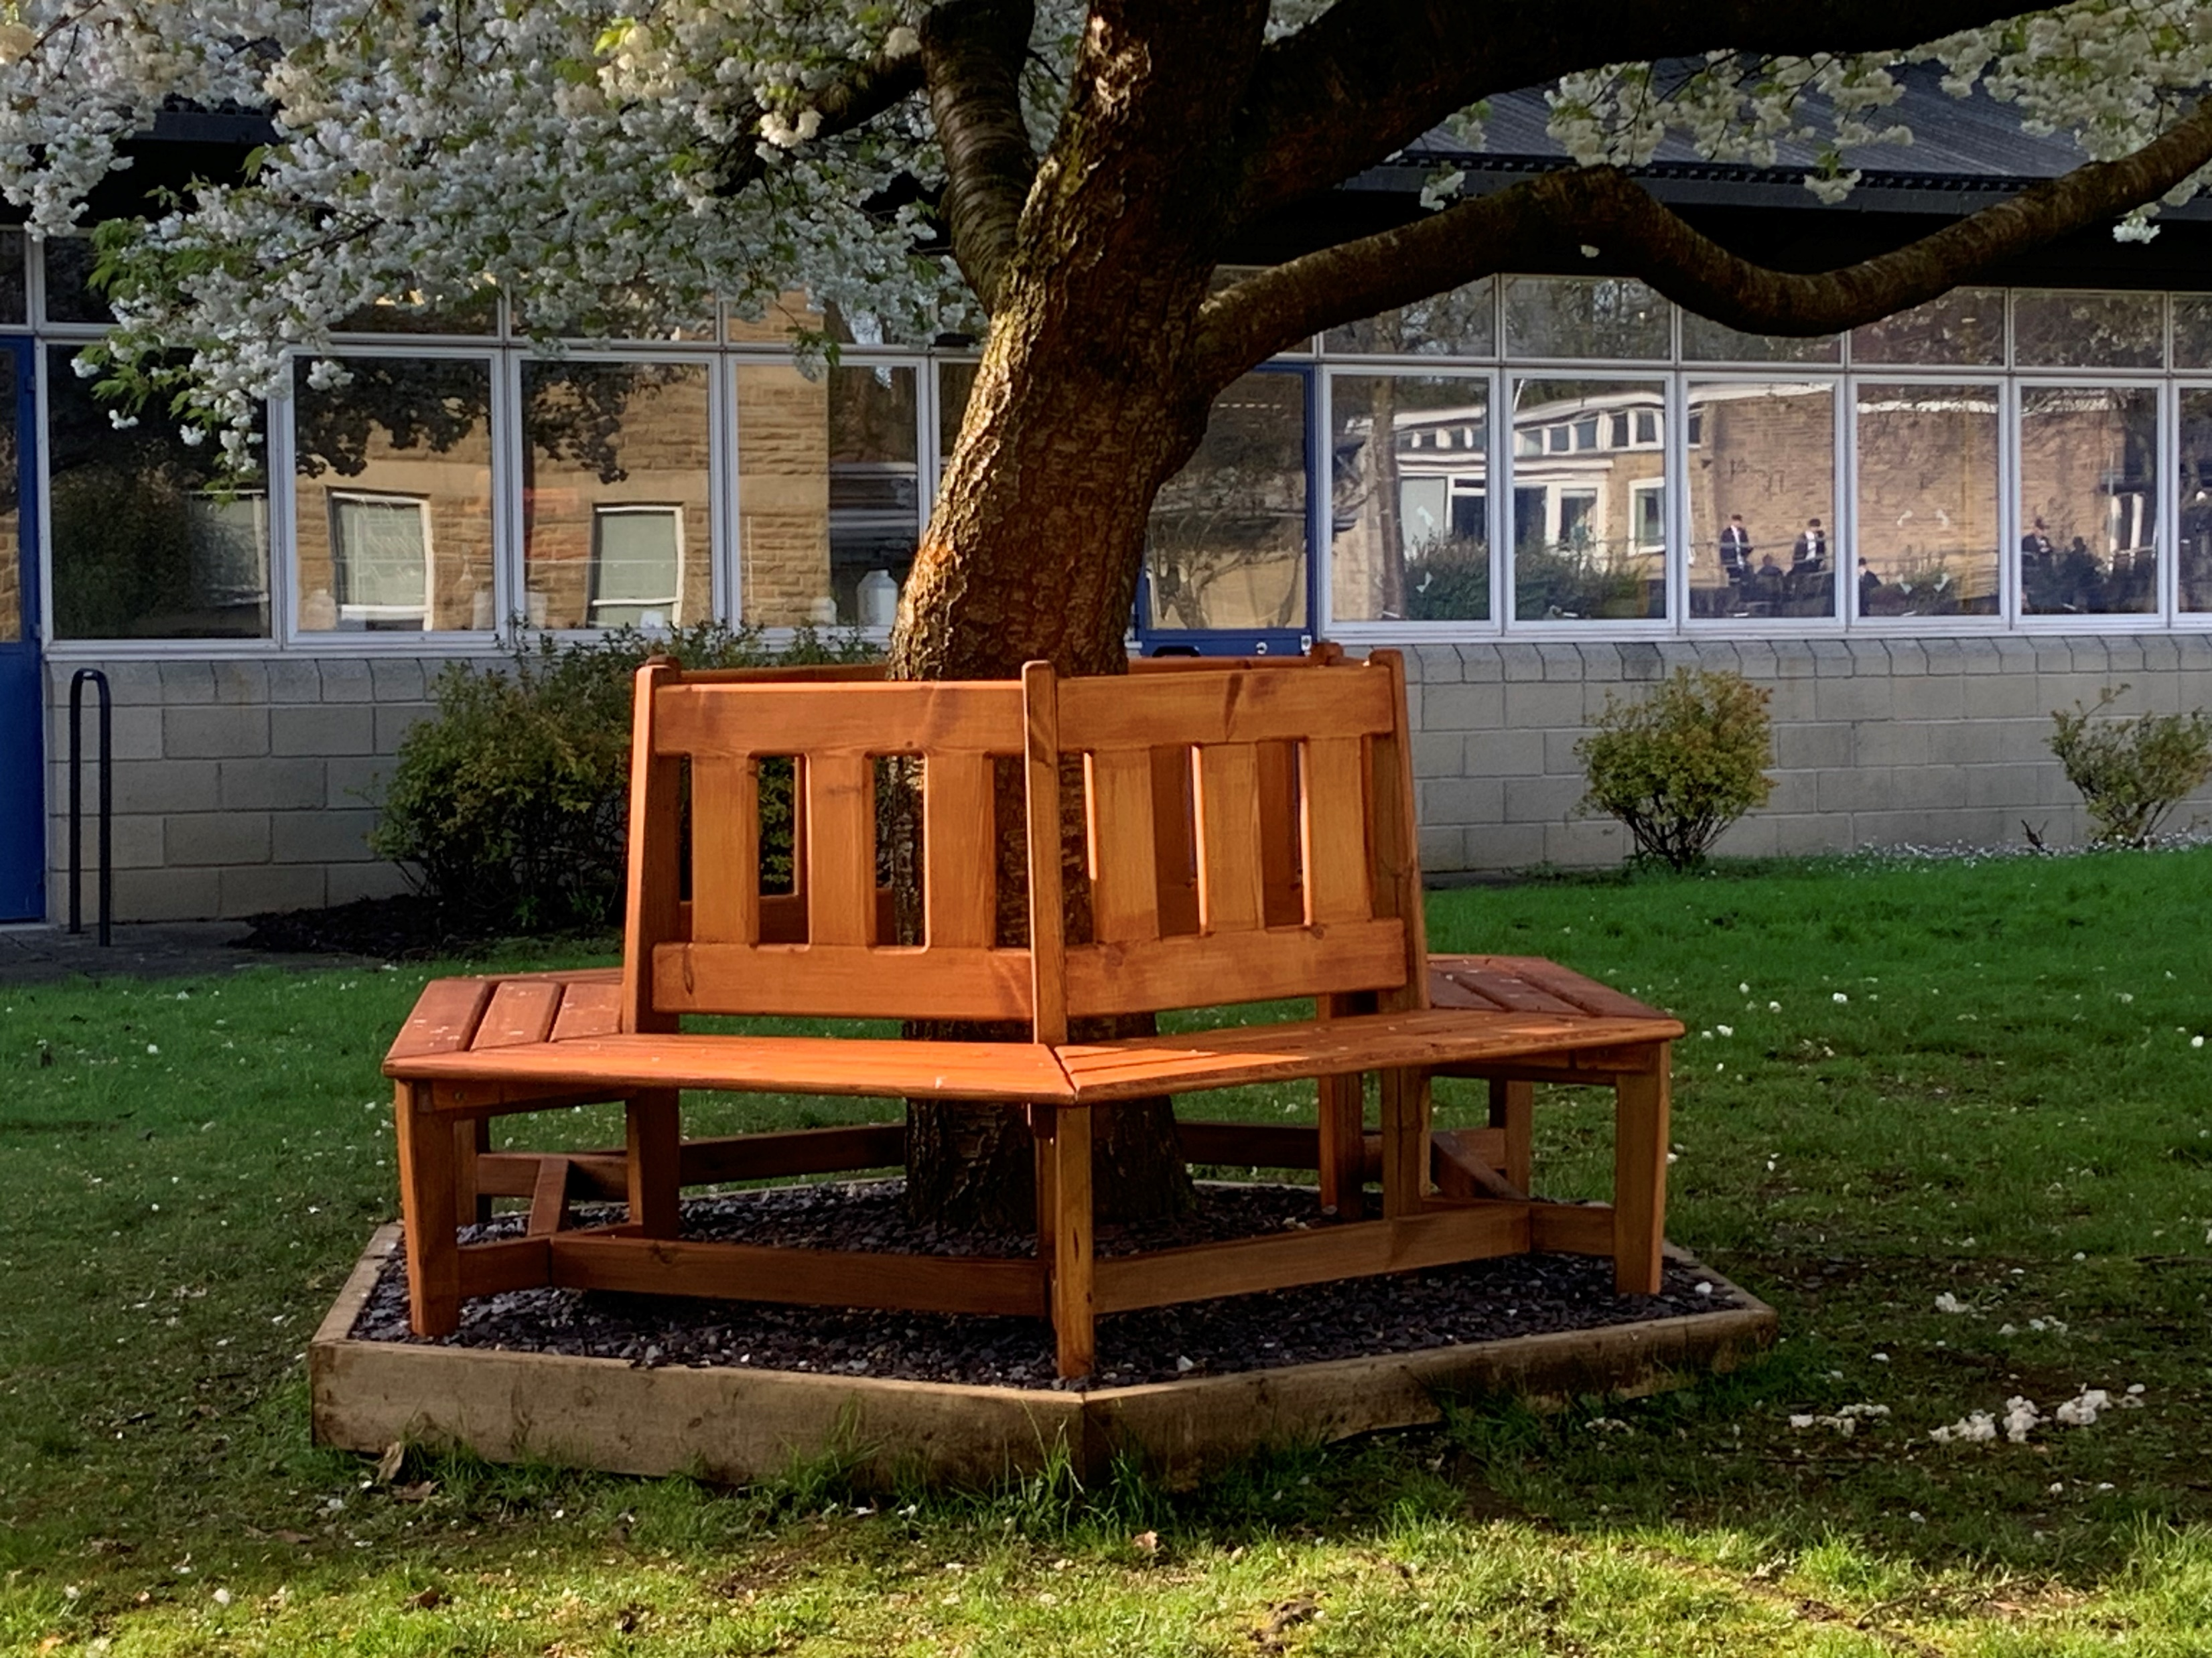
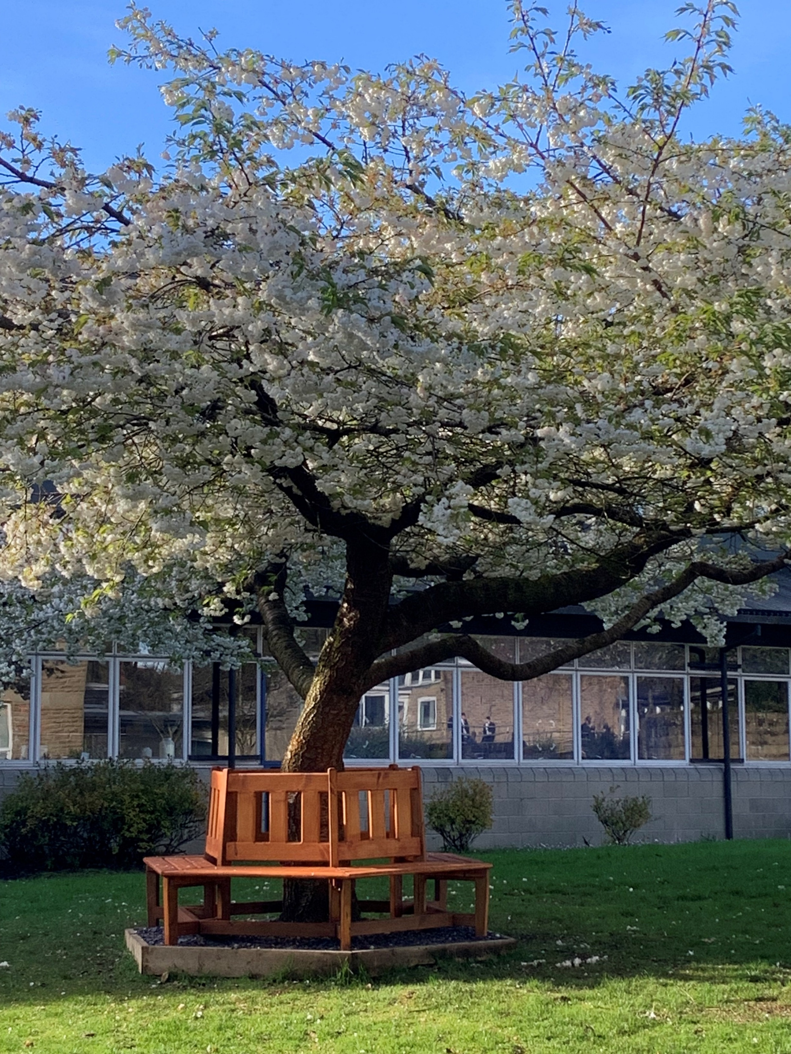

Slide 7
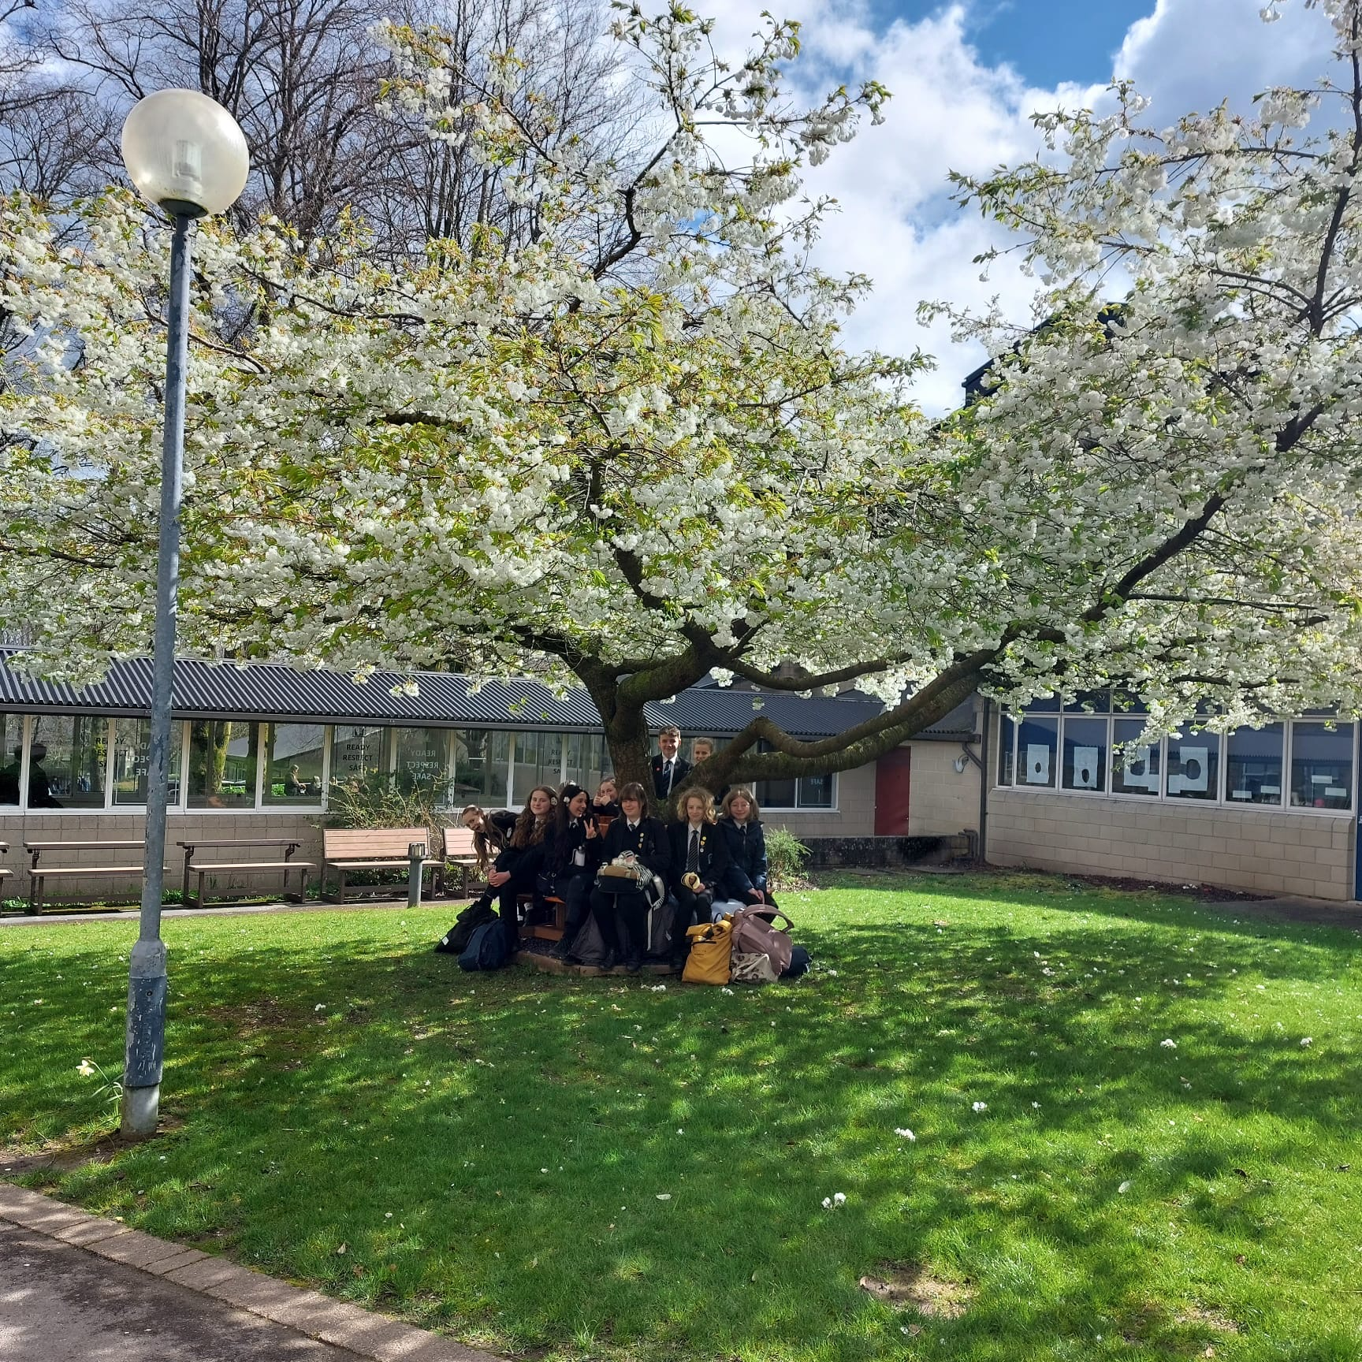
Memorial Bench
I hope you can make the effort to go and see the lovely bench in the next few weeks, while the white cherry blossom is out.
I also hope that as the weather becomes warmer, some of you can sit and enjoy the bench in the sunshine.
Thank you
Mrs Wentworth

