Slide 1


Edition: 18 Term: Winter
Editor: Luke Adkins
Photographer: Olivia
Climate Action Group
What is Christmas?
All about Boxing Day

Slide 2
1

Slide 3
Students Drive Climate Action Forward
By: BCS Climate Action Group
The Buxton Community School Climate Action Group has had an impactful term, making strides in our mission to combat climate change and promote sustainability within school. At the end of October, we took part in a Transition Buxton event at the Pavilion Gardens Octagon. Here, we presented our first-ever "Teach the Teacher" workshop, where we taught primary school Teachers and Teaching Assistants how to introduce climate education into the curriculum. The session received positive feedback, and we hope it has inspired Teachers to start teaching about the climate in clever ways, starting from a young age.
In addition to our educational efforts, we have taken on practical initiatives within the school. One of our biggest moves this term is the switch to recycled paper (specifically “Xerox Recycled”, not “EcoPrint” which is not Eco in anyway) — a change that will significantly cut down the school’s carbon footprint. By moving to recycled paper, the school will prevent carbon emissions equivalent to the energy use of 118 homes for an entire year!
We have also had success in the community by encouraging the Buxton Football Club Chairman, David Hopkins to switch to using reusable drinks cups at Sliverlands. This saves mountains of plastic from landfill and saves the Football Club hundreds of pounds a year in buying disposable plastic cups.
We attended the 2024 Buxton Youth Climate Conference organised by Transition Buxton, we met with multiple local stakeholders including Derbyshire Wildlife Trust, Buxton Civic Association, Derbyshire County Council, New Mills Incredible Edibles and Serpentine Community Garden
Our next projects will be helping in finding ways for school to cut our energy and water costs through renewable sources or energy saving measures and the creation of a BCS Allotment to grow our own fruit and veg for the school and local community.
The Climate Action Group meets every Wednesday lunchtime in A7 and is always welcoming new members. If you’re interested in joining the fight for a greener future, this is a great way to make a difference!
2

Slide 4
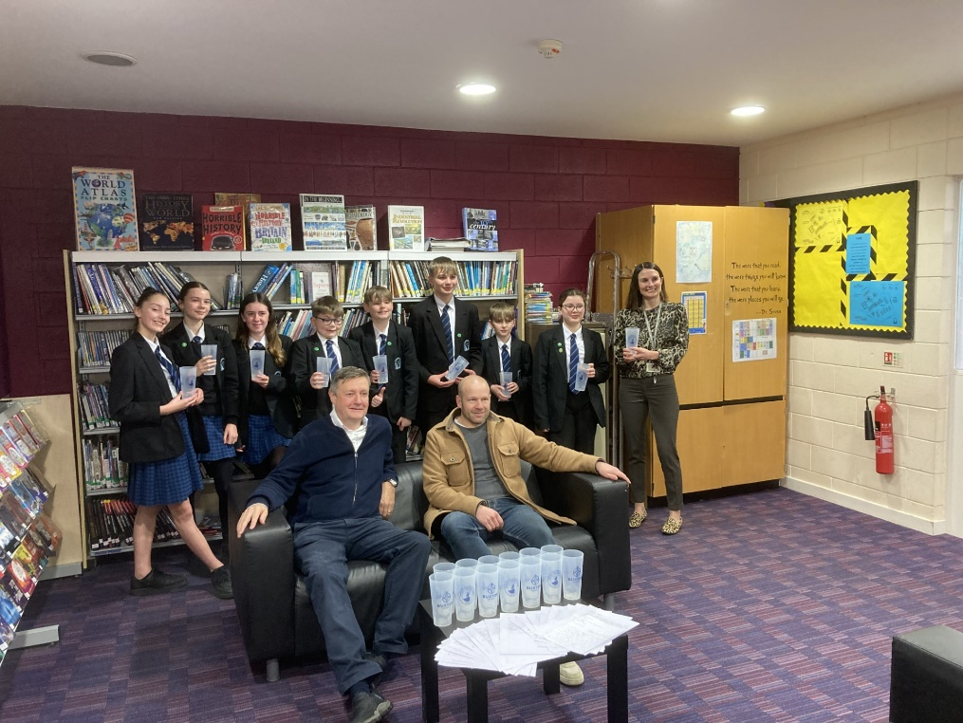

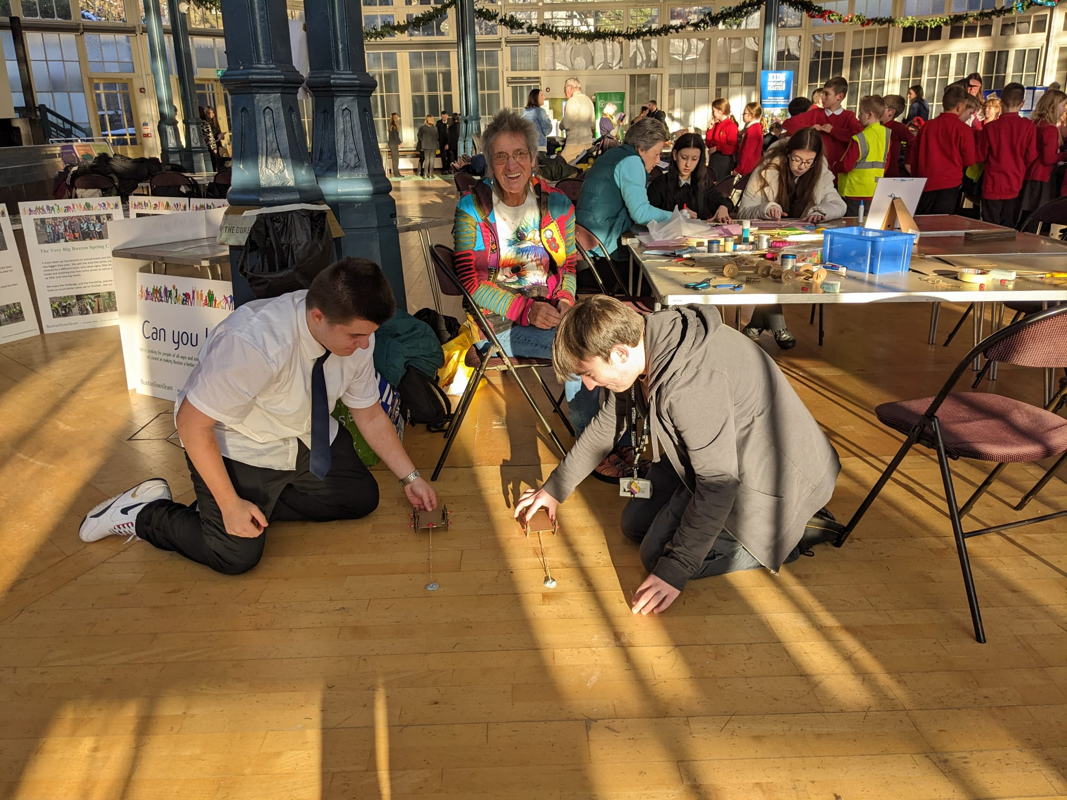
3

Slide 5
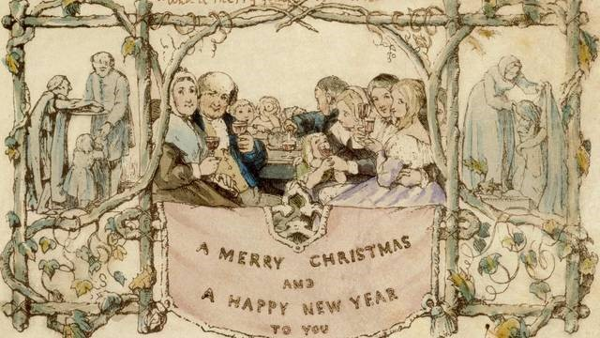
What is Christmas?
Christmas is an annual festival celebrating the birth of Jesus Christ. It is held on 25th of December. Christmas Day is a public holiday in many countries and is celebrated religiously by a lot of Christians, as well as culturally by many non-Christians, and has become a huge part of the winter season. The traditional Christmas story, commonly known as the Nativity, says that Jesus was born in Bethlehem. When Joseph and Mary arrived in the city where Joseph was born, the inns had no room, and so they were offered a stable where Jesus was soon born, with gifts from three wise men who had travelled far following a star and surrounded by shepherds and sheep.
The customs associated with Christmas in various countries have a mix of themes and origins. Popular holiday traditions include gift giving; completing an Advent calendar, Christmas music and carolling, watching Christmas movies, viewing a Nativity play, an exchange of Christmas cards, attending church services, a special meal, displaying various Christmas decorations [including Christmas trees, Christmas lights, nativity scenes, garlands, wreaths, mistletoe, and holly]. Additionally, Santa Claus [also referred to as Father Christmas and Saint Nicholas] is also associated with bringing gifts to children during the Christmas season. Because gift-giving [and many other aspects of Christmas] involve heightened economic activity, the holiday has become a significant event and a key sales period for retailers and businesses. Over the past few centuries, Christmas has had a steadily growing economic effect in many regions of the world.
Did you know?
The first commercial Christmas card was produced by Sir Henry Cole in London in 1843.
This is what it looked like.
4

Slide 6

Boxing Day
By Natalie
Boxing Day is the day after Christmas, 26th December. It is never really celebrated in the modern world, but in the past, it was an important celebration.
The name Boxing Day originates from Victorian times. They gave it the name Boxing Day because the rich would put items that they no longer needed into boxes to give to the poor who did need them.
Boxing Day was also the servants’ day off from work, so they could spend their valuable time with their family. This was because the servants would do hard work to help the richer people that they served.
After a long period of time the Puritans took over and forced a ban on this tradition. All of the churches that had alms boxes were all closed, and many were left for ruin.
The first time that Boxing Day was mentioned was in a diary from 19th of December 1663.
5

Slide 7
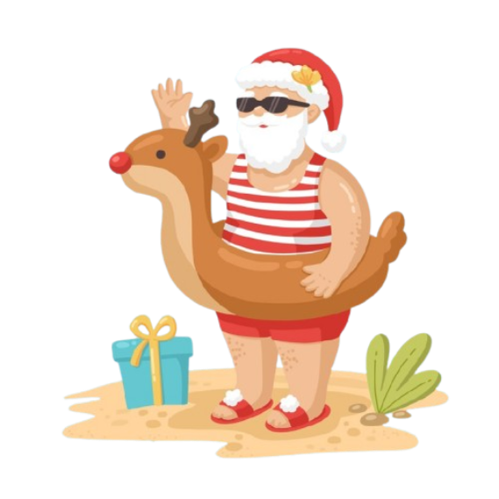
A typical Australian Christmas
Some people use native Australian plants like eucalyptus instead of traditional pine trees for Christmas.
What they do all day?
They'll spend the day at the beach, have picnics in parks, or even dip in the sea. Even the nightlife on Christmas is outdoors. Carols by Candlelight is a concert featuring live performances by national and international celebrities, where families spend the evening listening to music and singing carols together.
What do they call Santa?
Now, many countries around the world use Santa or their own variant of this name – to describe the iconic Christmas figure. English-speaking countries such as the USA, Canada, Australia and the UK all commonly use this name, alongside the more traditional Father Christmas.
Does Bondi keep shops open Christmas?
Several attractions remain open on Christmas day in Sydney, such as Taronga Zoo, SEALIFE Sydney Aquarium and WILDLIFE Sydney Zoo. Many cinemas across the city open their doors on Christmas, including venues by Hoyts, Event and Palace Cinemas.
8

Slide 8

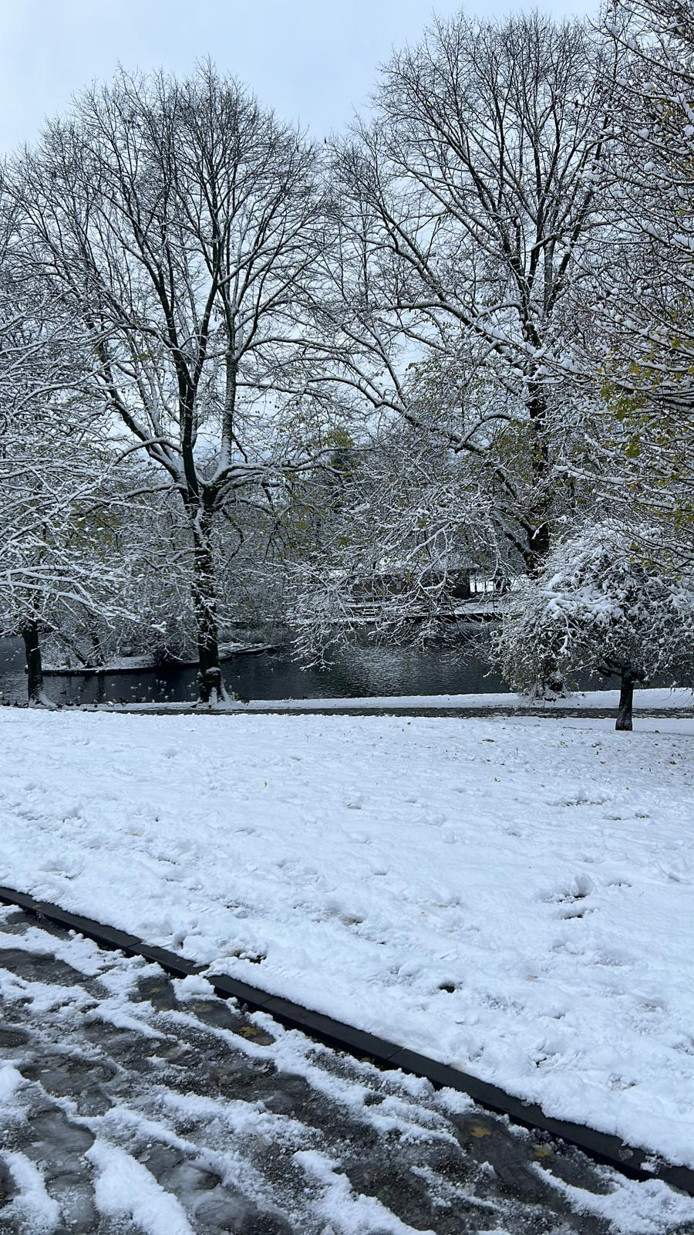
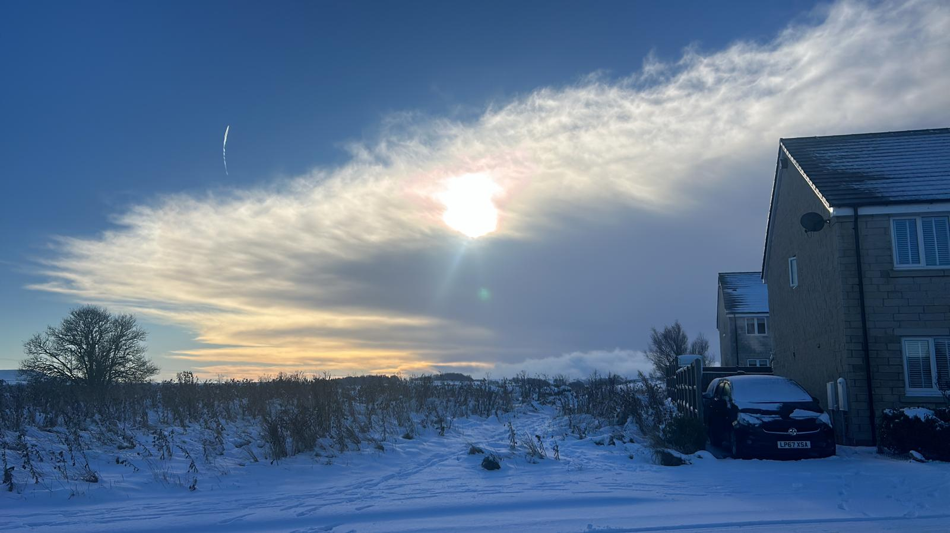
6

Slide 9
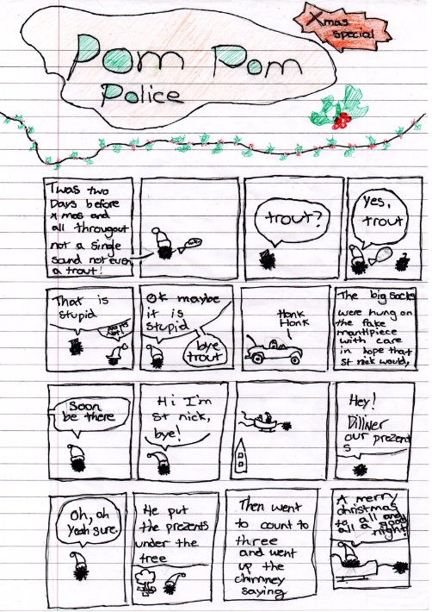

Slide 10
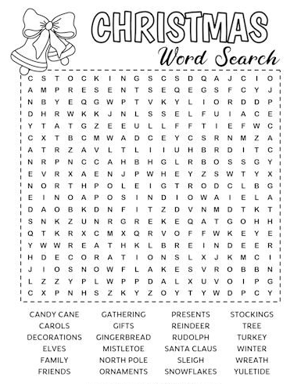
Festive Puzzle:
10

Slide 11

Farewell Luke!
From everyone here at the BCS Press we’d like to thank our Editor Luke Adkins for all his hard work and dedication bringing together our team and so many editions, without him it wouldn't have been possible. He will be stepping down as Editor in the new year, but we hope you’ve all enjoyed reading our newspaper and look forward to seeing you then.
Thank you!
From everyone here, have a Happy Christmas!
7

Slide 12
Our Team:
Luke Adkins (Y11) - Editor, Writer
Finlay Jones (Y10) – Deputy Editor, Writer
Max Sherwood (Y10) – Logo Design
Olivia Bell (Y8) - Photographer
Heath Koontz-Garboden (Y8) – Illustrator
Grace Byrne – (Y8) Writer
Erin Chipp (Y8) – Writer
Chloe Hu (Y8) – Writer
Willow Jones (Y8) – Writer
Natalie Teeboon (Y8) - Writer
theBCSPress team are always looking for new people to join. We are looking for anybody who would like to write about any issues or events that could be happening in the school or for young people in general.
You could join us as a regular writer, adding content to all our editions, or you could join us on a freelance basis. Writing in just one or a few of our editions.
If you would like to come along to our meetings, we meet in D29 at 12:30 on a Tuesday Lunchtime
11

Slide 13

YOU CAN ADD TO OUR NEWSPAPER
If You Want To Help With Our Newspaper, Come To Our Meetings Every Tuesday at 12:30 in D29
Mince Pie
Well done you made it to the back, have a Mince Pie

