Slide 1

Can you ‘FACE It’?

Slide 2

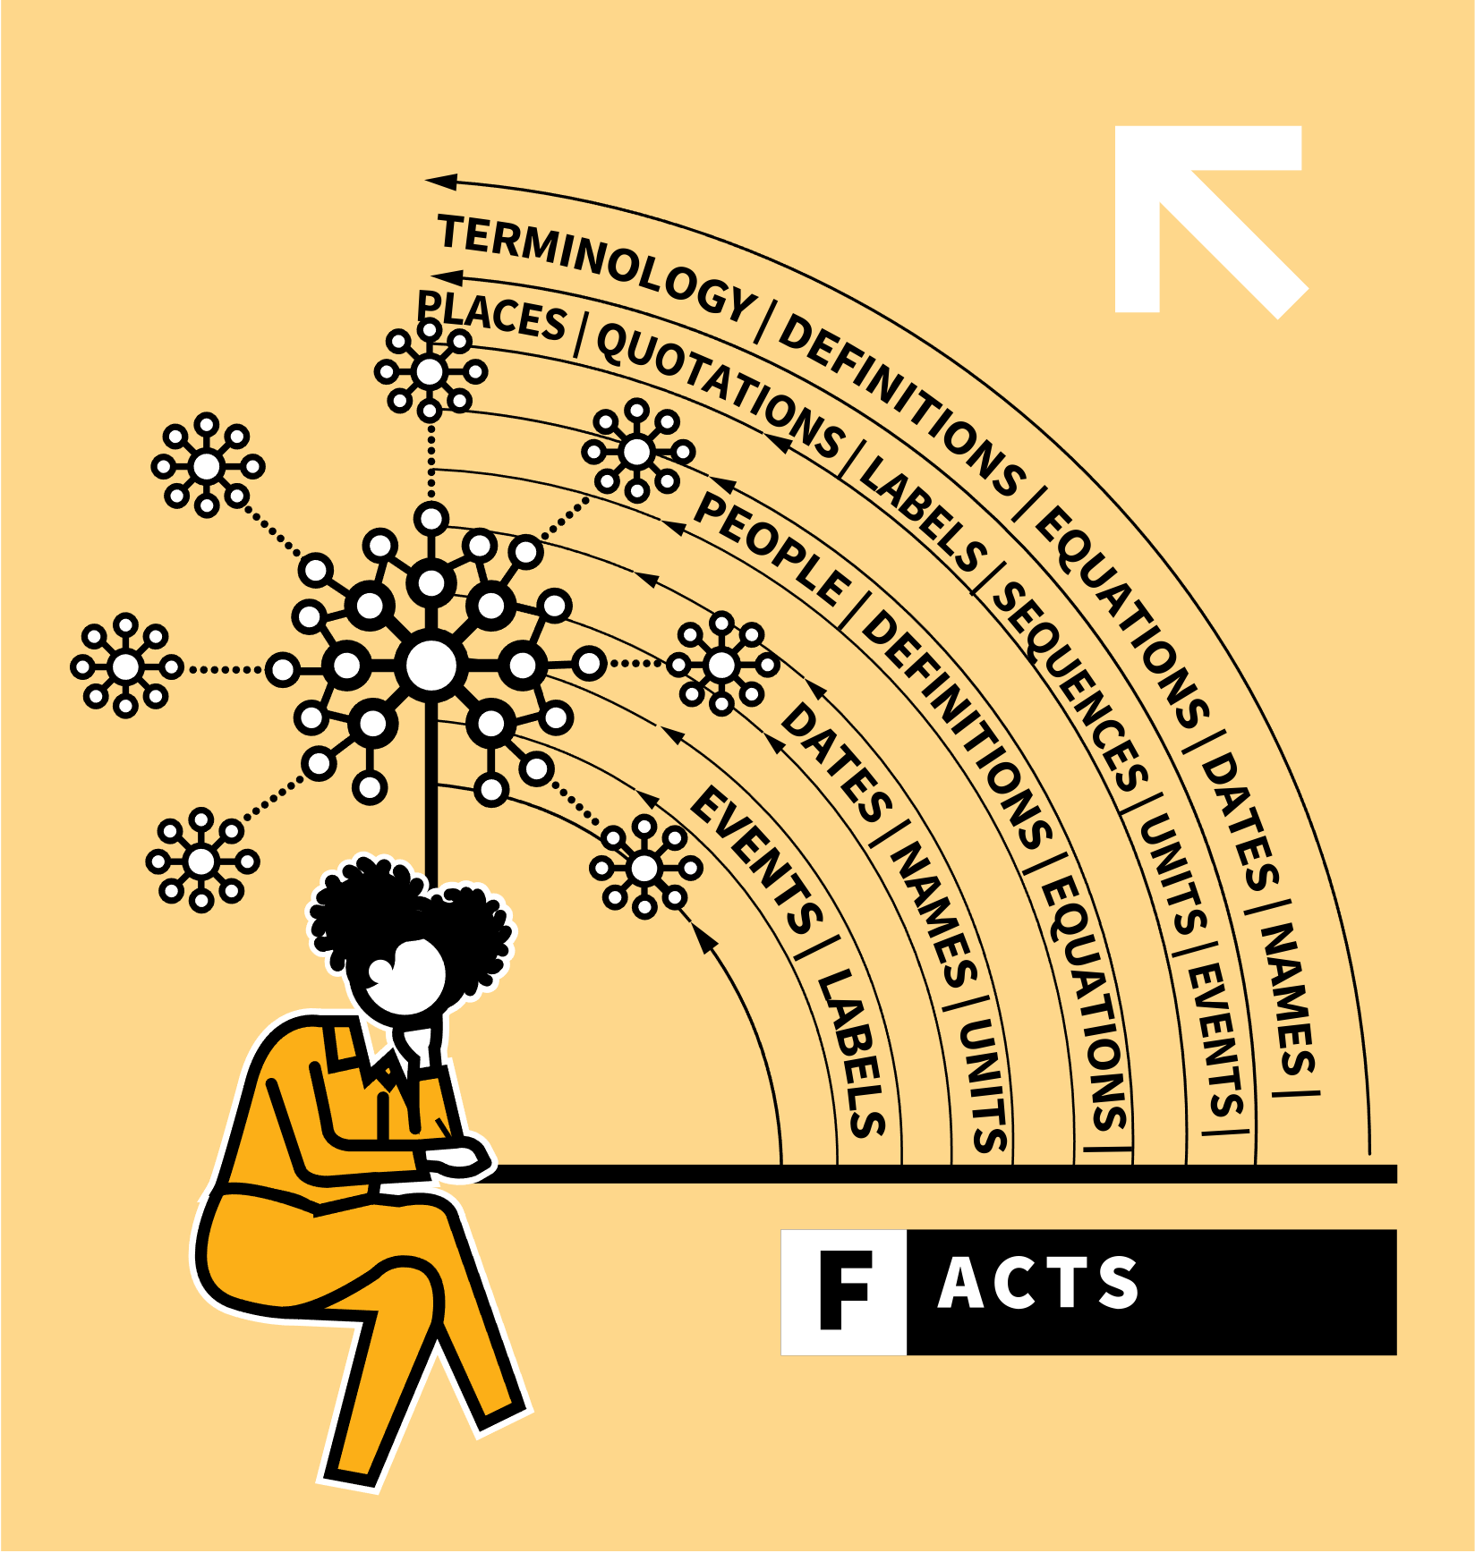
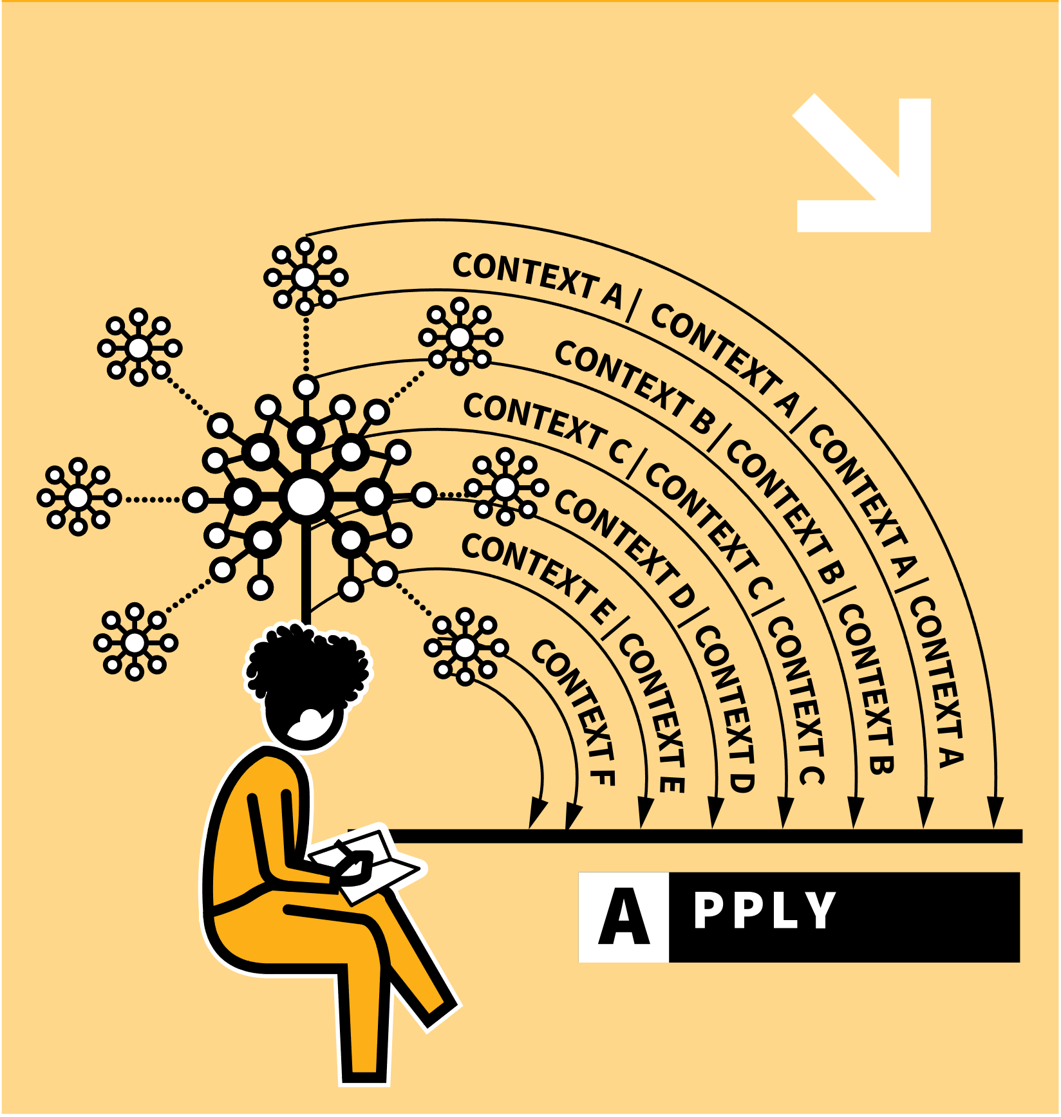

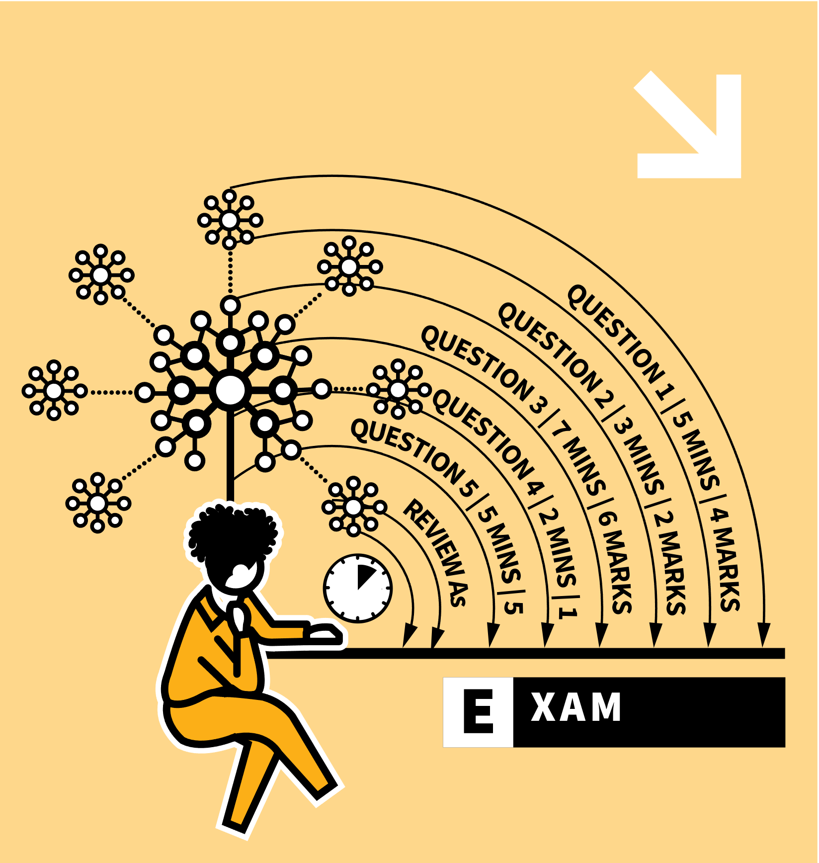
LEARNING WALKTHRUs
FACE IT
STUDY HABITS & TECHNIQUES SERIES
1
2
3
4
5
F | LEARN YOUR FACTS FIRST
A | APPLY YOUR KNOWLEDGE TO NEW PROBLEMS
C | CONNECT YOUR KNOWLEDGE WITH MORE COMPLEX QUESTIONS
E | PRACTISE IN EXAM CONDITIONS
REVISION TROUBLE? FACE IT
Most students will be faced with a large amount of material to revise for their exams, but there’s a process they will find helpful: FACE It.
Each letter represents some actions to take in order of difficulty.
The overall message for your child is not to avoid the revision process — but to face the challenge head on by taking actions that will be most useful to them.

Slide 3
LEARNING WALKTHRUs
1 | 2 | 3 | 4 | 5
STUDY HABITS & TECHNIQUES SERIES
FACE IT
F | LEARN YOUR FACTS FIRST
To begin, learn the core factual content in a topic:
  terminology, definitions, equations, dates, names, places, quotations, labels, sequences, units, events, people.
This is the quizzable knowledge that you might have on flash cards or knowledge organisers.
Use a range of retrieval practice techniques like self-quizzing, brain dumps and flashcard testing.

Slide 4


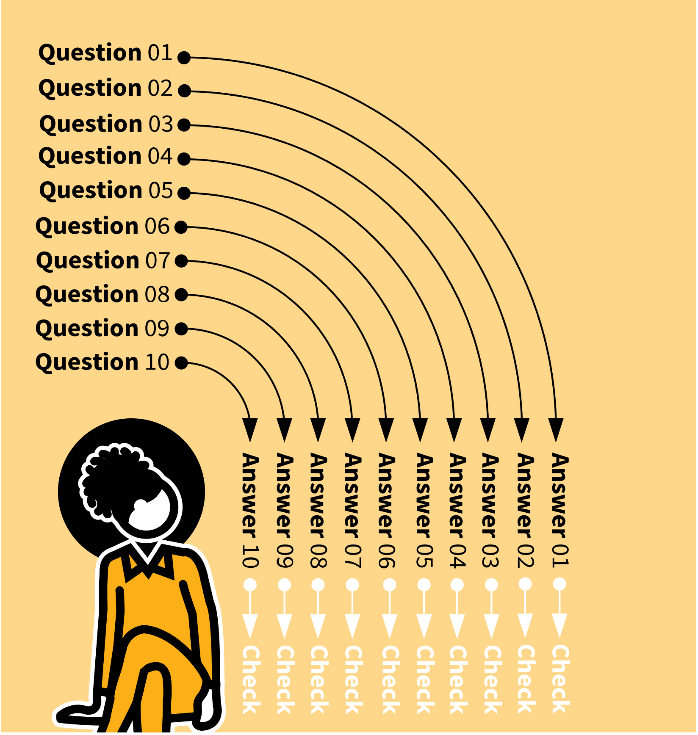
Flashcards
Brain Dumps
Self-Quizzing

Slide 5
LEARNING WALKTHRUs
1 | 2 | 3 | 4 | 5
STUDY HABITS & TECHNIQUES SERIES
FACE IT
A | APPLY YOUR KNOWLEDGE TO NEW PROBLEMS
With your facts more secure, tackle questions where the knowledge is tested in a context, beyond straightforward recall.
It’s not enough to know isolated facts; that knowledge needs to be used in context. This could be questions from worksheets, textbooks, revision websites/guides or exam papers.
If completing exam questions, start with shorter ones to build up your confidence with applying your knowledge.

Slide 6
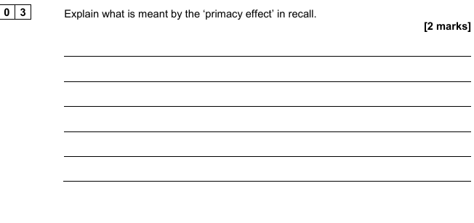
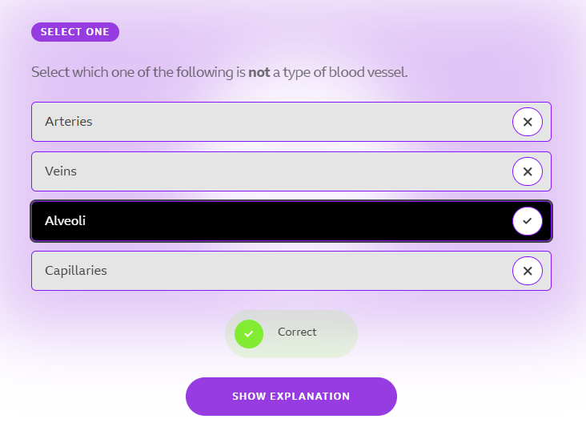
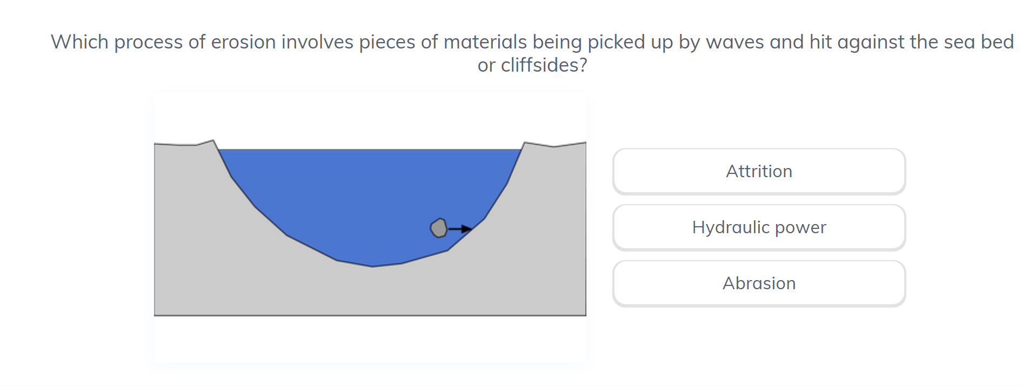

Slide 7
LEARNING WALKTHRUs
1 | 2 | 3 | 4 | 5
STUDY HABITS & TECHNIQUES SERIES
FACE IT
C | CONNECT YOUR KNOWLEDGE WITH MORE COMPLEX QUESTIONS
Attempt questions that require you to draw on knowledge from more than one topic area or to apply knowledge to previously unseen ideas.
You might need to identify patterns and links that haven’t been explicitly taught before.
Sometimes you may need to connect detailed ideas into a wider scheme of interconnected topics.
These will be the harder questions normally near the end of an exam paper.

Slide 8
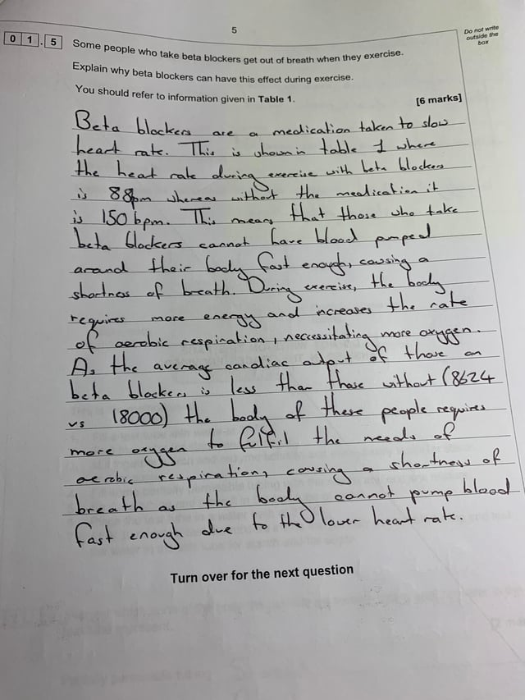
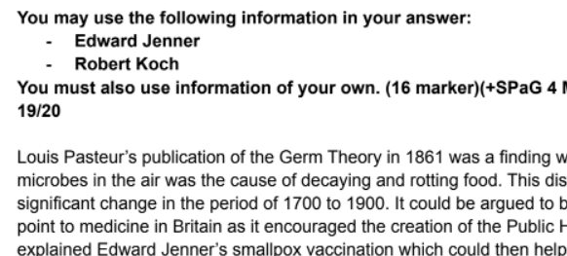
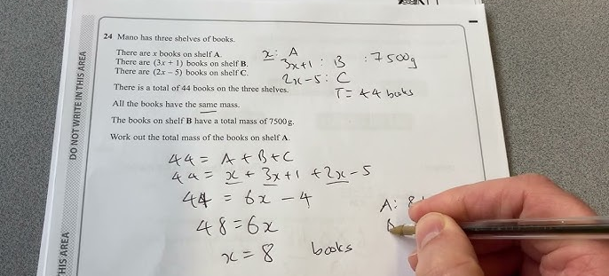

Slide 9
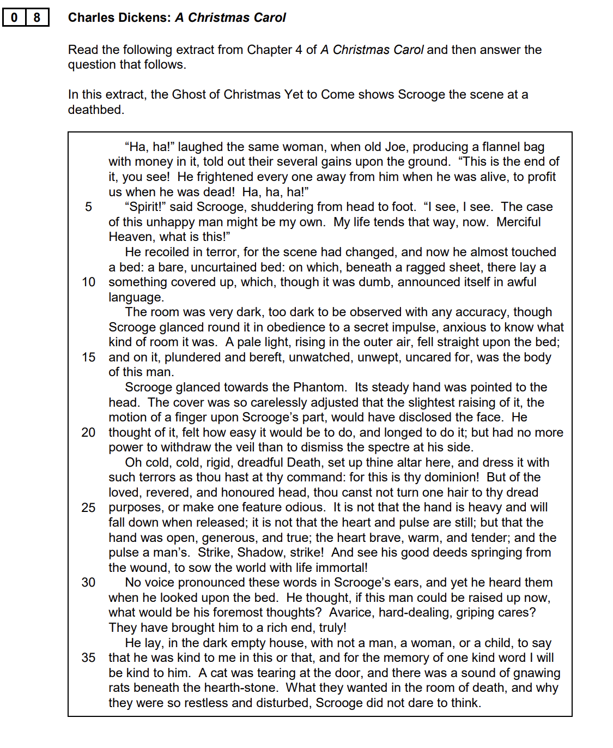
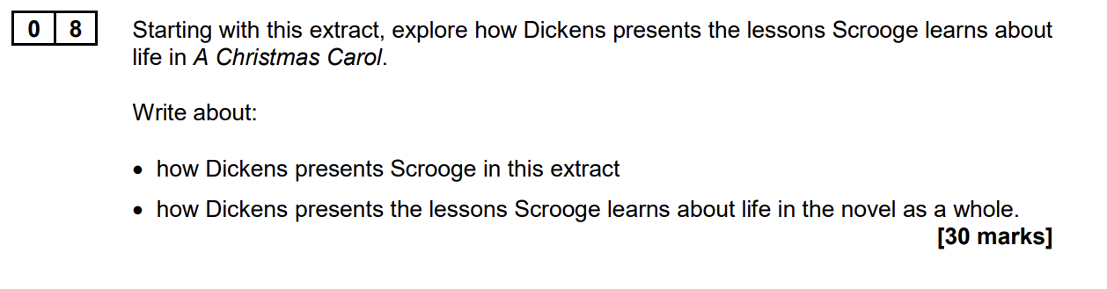

Slide 10
LEARNING WALKTHRUs
1 | 2 | 3 | 4 | 5
STUDY HABITS & TECHNIQUES SERIES
FACE IT
E | PRACTISE IN EXAM CONDITIONS
Use past exam questions to rehearse responding under time pressure, taking account of the marks available.
Do this once the FAC aspects are more secure. Trying to recall factual knowledge under a time limit is not advisable if you haven’t previously secured that knowledge in a more low-stakes situation.
When you feel you know the material well then see how well it goes in timed conditions.

Slide 11
LEARNING WALKTHRUs
1 | 2 | 3 | 4 | 5
STUDY HABITS & TECHNIQUES SERIES
FACE IT
REVISION TROUBLE? FACE IT!
Use FACE It to support your revision planning and as a diagnostic tool:
  Have you learned your Facts?
  Have you practised Applying your knowledge in context (start with shorter questions)?
  Have you started to Connect ideas with more complex, extended questions?
  Have you tested yourself in timed Exam conditions?

Slide 12
LEARNING WALKTHRUs
STUDY HABITS & TECHNIQUES SERIES
FACE IT
1
2
3
4
5
F | LEARN YOUR FACTS FIRST
A | APPLY YOUR KNOWLEDGE TO NEW PROBLEMS
C | CONNECT YOUR KNOWLEDGE WITH MORE COMPLEX QUESTIONS
E | PRACTISE IN EXAM CONDITIONS
REVISION TROUBLE? FACE IT
Effective revision can fundamentally transform exam preparation from a high-stress, last-minute rush into a structured, confidence-building process that can improve final exam results by up to 30%.
By replacing passive techniques like re-reading and highlighting with the FACE IT approach students will strengthen their long-term memory and exam readiness.

Slide 13


