Slide 1
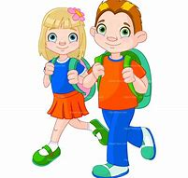

I am moving to Secondary School

Slide 2
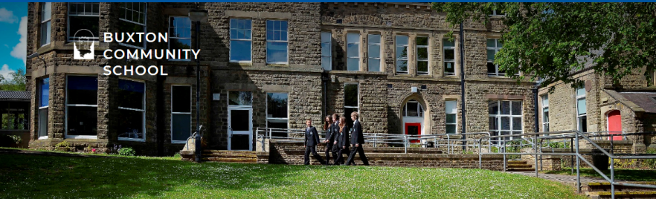
Young people stay at Primary School until the end of Year 6. This is because new students will start in Reception and the Year 6s need to go on to learn other things at Secondary School. Young people stay at secondary school for 5 years. They get to know their teachers really well and make new friends.
Some young people feel worried about changing school. This is understandable.
My Primary School will help me with my worries so that Buxton Community School know how I feel and can help me.
Why do we have to change school?

Slide 3
There are 3 different ways into the school. Some are quieter than others. Green Lane tends to be quieter in a morning. This entrance is closest to Learning Support and my Year 7 Pastoral Manager.
Some students arrange to meet their friends in a morning. They always go to the same place to meet up.
Some students go to the Learning Support ‘Base’ in a morning as it is quiet and there are people there who will help them get ready for Lesson 1.
At Buxton Community School, my day starts at 8.50am when I go to my first lesson.
When I get to school in the morning

Slide 4
Students have a timetable of lessons and move from one lesson to the next. They keep their timetables in their pocket or their bag so they are handy. If students do not know where to go, there are lots of adults and older students in school who will help them.
The subjects are grouped together and not spread out. There are maps to help you find your way.
In Year 7, students are taught as a tutor group. This means that all of the class will go to their next class together. This is very helpful. If I am not sure where to go, I can follow the rest of my class or ask an adult.
At Buxton Community School, I will soon learn may way around and there are lots of people who will help me.
How do I know where to go?

Slide 5
You will have a different teacher for each subject. They teach in the same room which is helpful when learning our way around. They will tell you where to sit.
There name will be written on my timetable in case I forget.
At Buxton Community School, I will get to know my different teachers and remember their names.
My teachers

Slide 6

Some students go to the Large Dining Hall to buy their food. They queue up outside and teachers tell them when they can go in. Some students are allowed to go into dinner a little bit early when it is quieter.
Some students bring a packed lunch to school. Some eat this in the Dining Hall. Some students eat their lunch in the Learning Support Department (we call it. ‘The Base’). They like it here because it is quieter and there are Teaching Assistants in there.
When the weather is nice, some students eat their packed lunch outside.
At Buxton Community School, I will be helped to find somewhere to eat my lunch.
What do I do at break time and lunchtime?

Slide 7


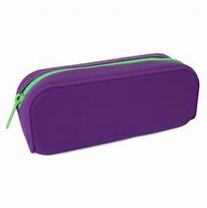
It is good to be organised. It is a good idea to pack our bag the night before, ready for the next day. Parents can help with this so we don’t forget anything. You will need a pencil case with a pen, pencil, rubber and rule. Some students have their own Math Set and calculator.
You need to pack my exercise books for the lessons you have on that day. You do not need to carry all your books around, just the ones that you need. Some people have a locker to keep their books and PE Kit in. If you wanted a locker, your parents would let school know and we would show you where it is.
At Buxton Community School, there are people who will help me to remember things.
What do I need in my bag?

Slide 8

Buxton Community School will give me a planner.
This is like a diary. It will have a copy of your timetable in it. You will write down your homework and when it is due to be handed in. Your parents will look at you planner every night to help you.
My planner will help me to remember important information.
What helps me stay organised?

Slide 9

Every day, you will see your form tutor. You will meet them before you start in September. You will get to know the very well and they will help you with all sorts of things. Your form tutor is a good person to talk to if you have forgotten something or are unsure of something. Every Monday, you will have an assembly with all the other Year 7s. This will be in the Dining Hall.
Mrs Siddons is my Pastoral Manager. She helps all Year 7 students.
At Buxton Community School, I will soon get to know who is able to help me.
Who can help me?

Slide 10

There are lots of toilets in school. Some students have a favourite. They prefer to always go to the same ones. At primary school, you make sure we go to the toilet at break or lunchtime. Sometimes people forget or need to go during a lesson.
It is always best to go to the toilet during break/lunch.
If I need to go to the toilet during a lesson, I will raise my hand and ask the teacher.
If it is close to break or lunchtime, the teacher may ask me to wait.
If I cannot wait, I will tell the teacher that it is urgent.
What happens if I need the toilet?

Slide 11

Some people walk to and from school.
Some people get a lift to school in a car.
Some get the bus.
I will need to talk to my parents about how I will get to school and how I will get home.
Home time

Slide 12
You can use this page to write down any questions or worries you may have. Your Y6 teacher will ask someone from Buxton Community School to answer them for you.
I still have questions

