Slide 1
Year 11 Computer Science
Revision evening
Mrs Wentworth
Mr Warhurst
.I will provide all resources mentioned in this presentation to your child, please ensure they have a USB memory stick to save the resources to.
I will give them the opportunity to do this in lesson.

Slide 2
OCR GCSE Computer Science
Is now 100% summer examination.
Components of a computer system 50%
Computational Thinking 50%
The controlled assessment 20 hours has almost been completed but this no longer counts towards the final grade.
Every student has a comprehensive set of theory notes currently kept in school.

Slide 3
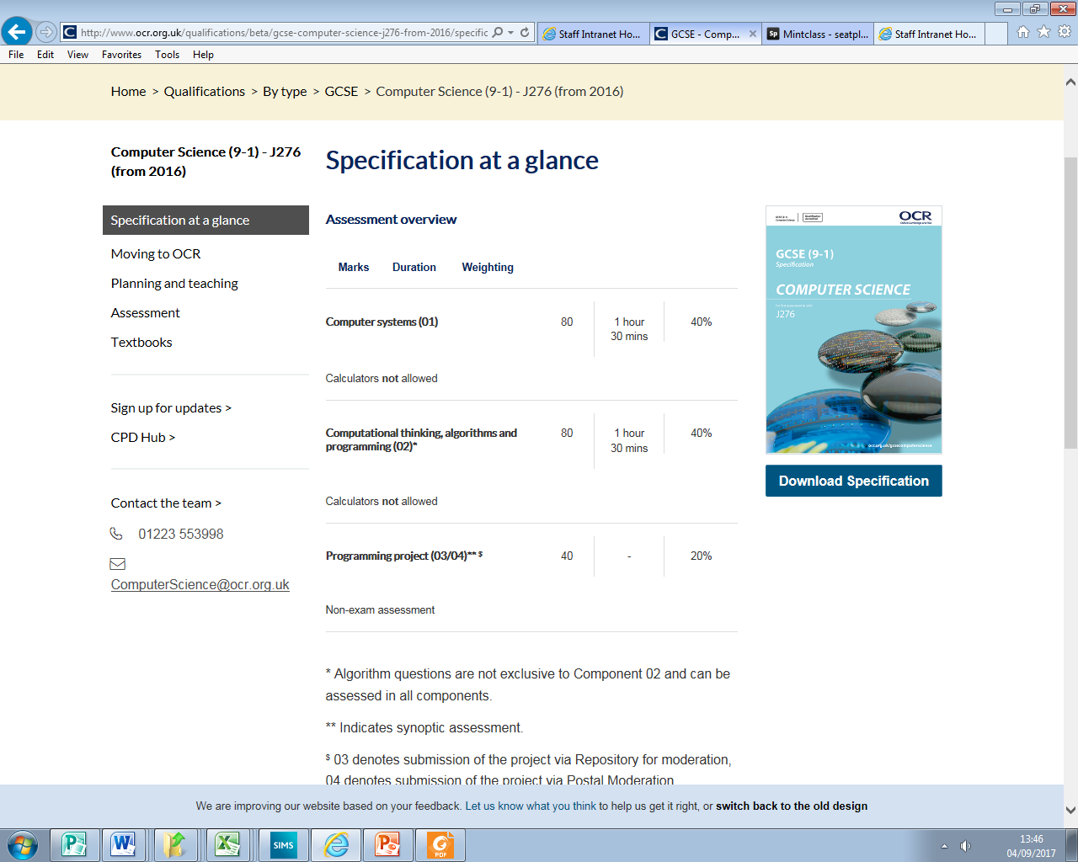
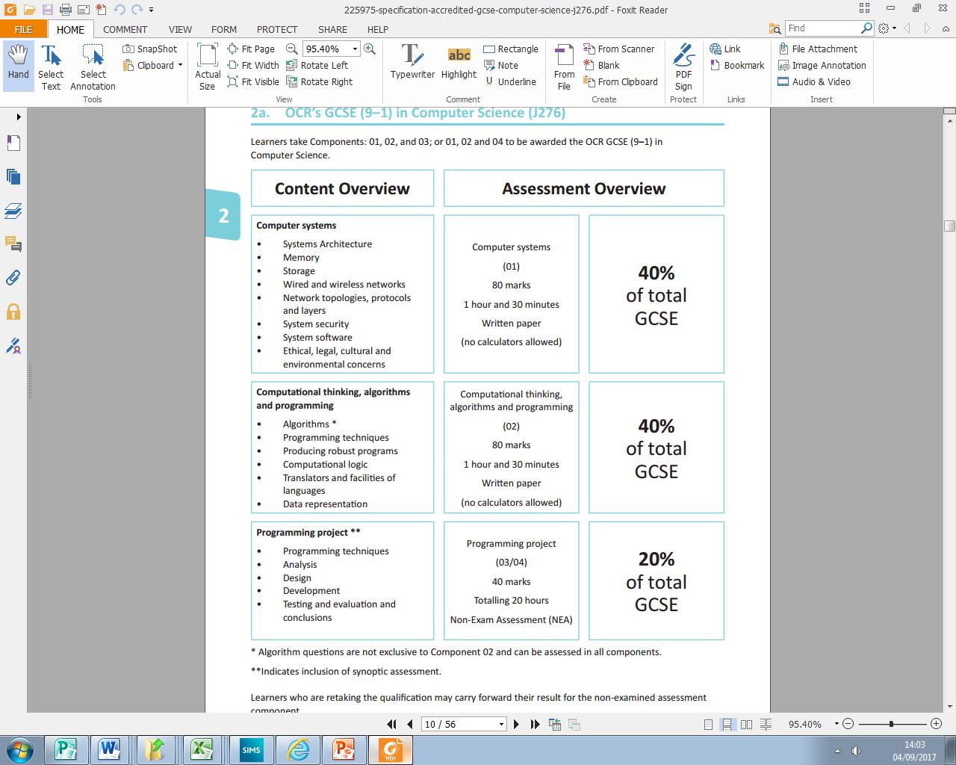
Course Content
Component 01: Computer systems
Introduces students to the Central Processing Unit (CPU), computer memory and storage, wired and wireless networks, network topologies, system security and system software.
50% of total grade.
It also looks at ethical, legal, cultural and environmental concerns associated with computer science.

Slide 4
Course Content
Component 02: Computational thinking, algorithms and programming
Students apply knowledge and understanding gained in component 01. They develop skills and understanding in computational thinking: algorithms, programming techniques, producing robust programs, computational logic, translators and data representation.
50% of total grade.
The skills and knowledge developed within this component will support the learner when completing the Component 03 Programming Project.

Slide 5
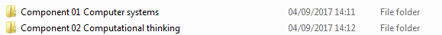
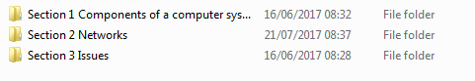
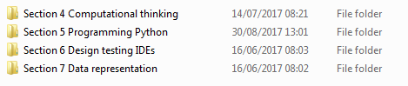
Theory: Folder structure for you to copy
Inside component 01 Computer systems all PowerPoints and notes
Inside component 02 Computational thinking all PowerPoints and notes

Slide 6
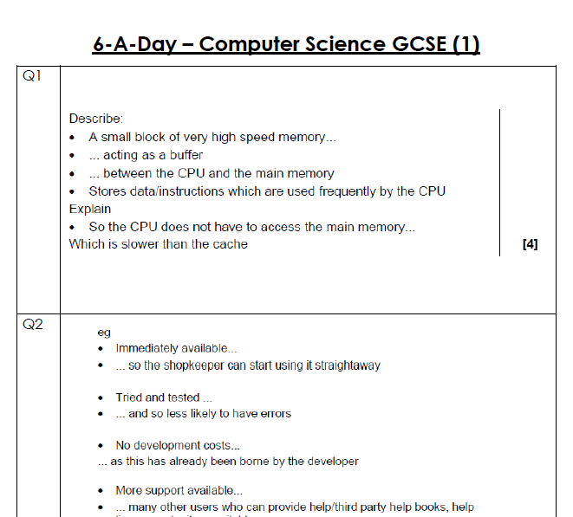
Extra revision materials
Also available for students to copy to usb pen drives are 31 sets of 6 previous exam questions with answers.
These sets of question and answers cover both Computer Systems and Computational thinking exams.

Slide 7
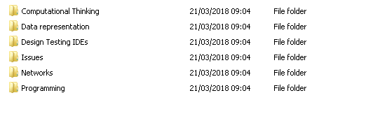
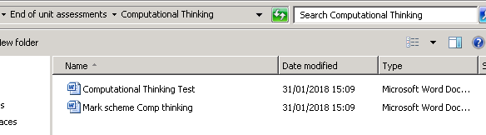
End of topic assessments
All end of unit assessments with the mark schemes are also available for students to copy and work through at home.

Slide 8
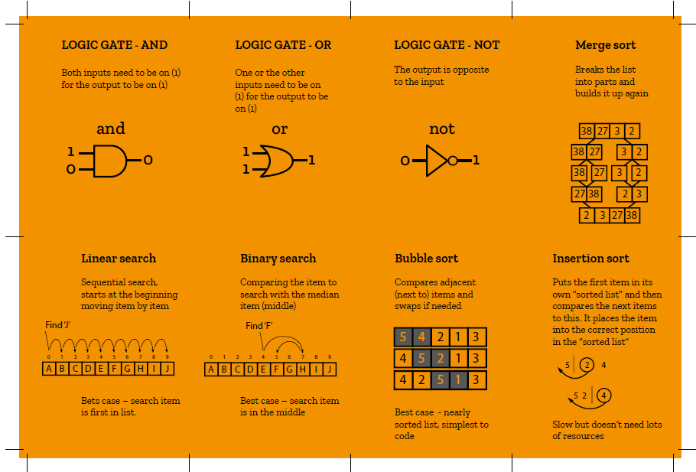
Revision cards
A full set of pre made revision cards that cover the whole syllabus.
These can be printed in school.

Slide 9
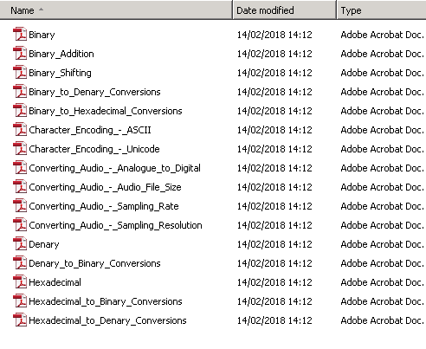
Data representation (computational thinking)
A set of really concise well written notes that covers the whole of Data representation.
Again printable in school and available to be saved on pen drive

Slide 10
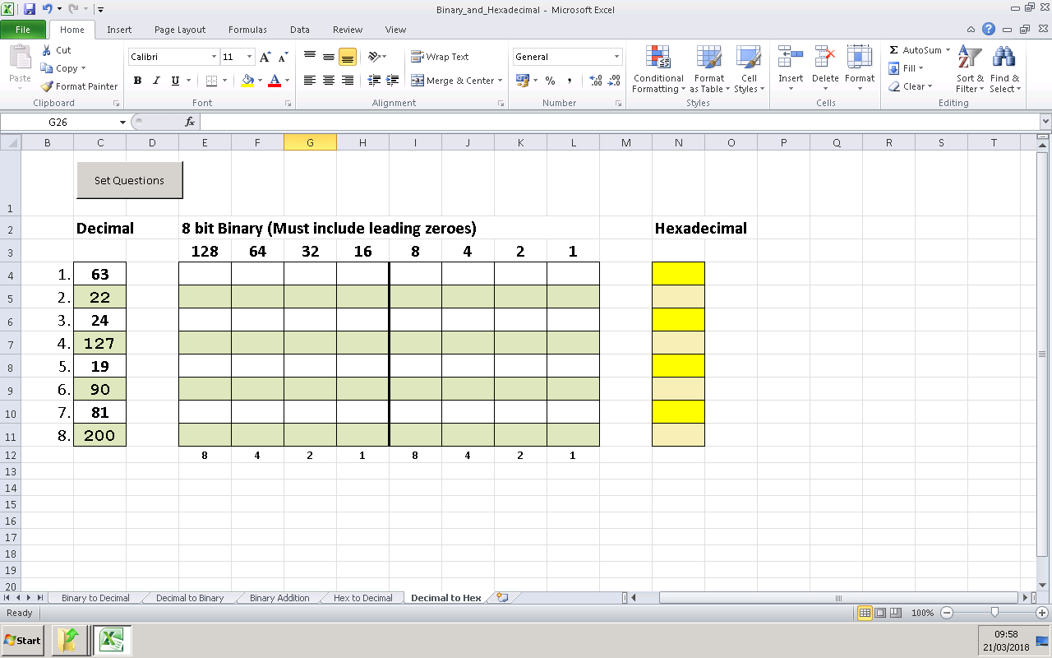
Binary, Hexadecimal
A set of spreadsheet tests that change when you click set questions. The sheet shows you a tick when your answer is correct.
This is a great way for parents to help students to revise and see their progress.

Slide 11
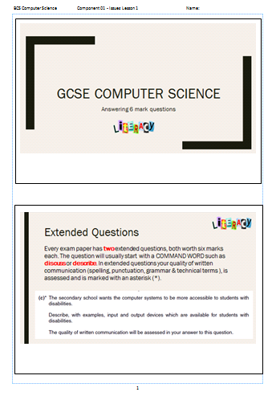
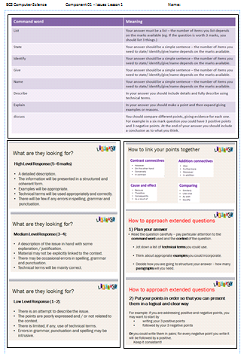
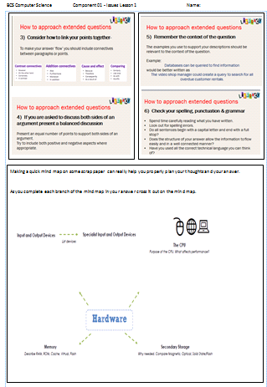
Six mark questions guidance – 2 per paper
A range of 6 mark questions with answers also provided

Slide 12
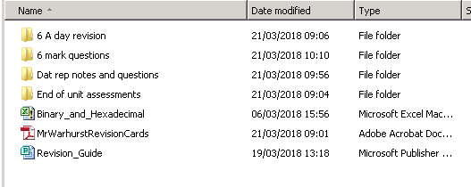
Extra resources for students to copy
All resources and revision materials mentioned in the presentation are available for students to copy and work through at home.
All I ask is that they have a USB pen drive so that they can copy the materials.

Slide 13
Past papers and specimen papers
Each student will sit several past papers and the two specimen papers released by OCR prior to their exams.
I would highly recommend each student make copies of these papers and practices them at home for revision.

Slide 14
How can parents help?
Ensure that your child has a revision timetable:
  Tutors will have helped them to develop this timetable already.
Help students to stick to the timetable via reminders, incentives and positive praise.
Try to engage in the revision by asking questions:
  There will be many questions with answers for you to use.
  6 a day questions, Binary spreadsheet, 6 mark questions, past papers with answers
Encourage regular breaks 30 minutes revision then take a break
  Eat, drink, walk around then do another 30 minutes

