Slide 1







MFL GCSE
We will look at:
What themes are covered.
What skills you will need.
What the exams look like.
Revision resources and how to revise.
Notes:
Introduce self, explain don’t need to write notes down as there is a handout.

Slide 2
THEMES
The themes that you will study are:
Theme 1: Identity and culture .
Theme 2: Local, national, international and global areas of interest.
Theme 3: Current and future study and employment.
These themes are based on previous knowledge and work covered during KS3.

Slide 3
SKILLS
The skills you will need are:
Translation into and from the TL.
Knowledge of key grammatical concepts including verb formation and tenses, adjectival agreement, word order and the gender of nouns.
Accurate pronunciation of TL phonics.
Interpretation of written and spoken TL.

Slide 4
EXAMS
Tested over 4 papers including reading, writing, listening and speaking and all are worth 25% . You will be entered into either the Higher or the Foundation Tier.
The speaking exam takes place in May and the other exams take place later in the Summer.
Notes:
Most will know the tier they are going to be entered in now. If not ask teachers!

Slide 5
READING
EXAM
Section A – Answer in English with a variety of question type (multiple choice, choose the correct name, tick the correct box and comprehension questions).
Section B – Answer in TL with a variety of question type (multiple choice, choose the correct name, tick the correct box and comprehension questions).
A range of formats will be used (announcements, news bulletins, conversations and telephone messages using a range of tenses and structures).
Section C – Translation from TL into English. FT – 35 words and HT – 50 words.
A range of formats will be used (brochures, guides, letters, newspapers and literary texts using a range of tenses and structures).

Slide 6
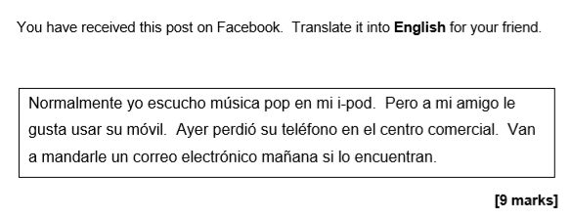
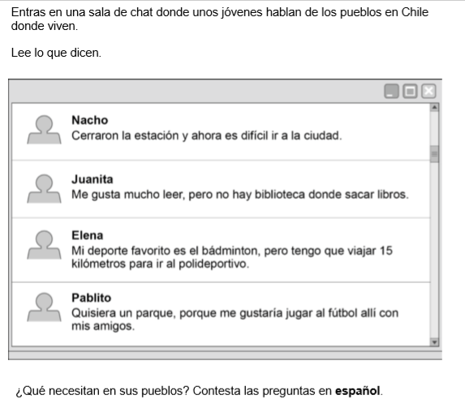

Slide 7
LISTENING
EXAM
5 minutes reading time.
Hear everything twice and there are pauses.
Section A – Answer in English with a variety of question type (multiple choice, choose the correct name, tick the correct box and comprehension questions).
Section B – Answer in TL with a variety of question type (multiple choice, choose the correct name, tick the correct box and comprehension questions).
A range of formats will be used (announcements, news bulletins, conversations and telephone messages using a range of tenses and structures).

Slide 8
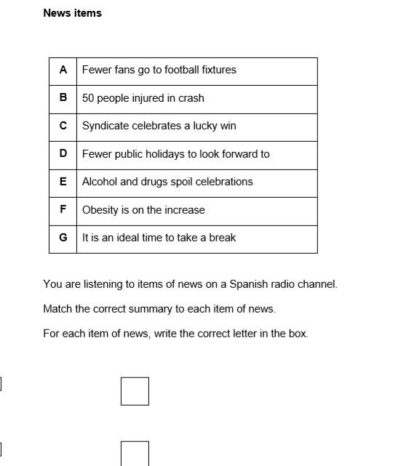

Slide 9
WRITING
EXAM
Foundation Tier
Question 1 – write short phrases.
Question 2 – 40 word piece.
Question 3 – Translation from English to TL (35 words).
Question 4 – 90 word piece. You get a choice of two questions.
Higher Tier
Question 1 – 90 word piece. You get a choice of two questions.
Question 2 – 150 word task. You get a choice of two questions.
Question 3 – Translation from English into TL (50 words).

Slide 10
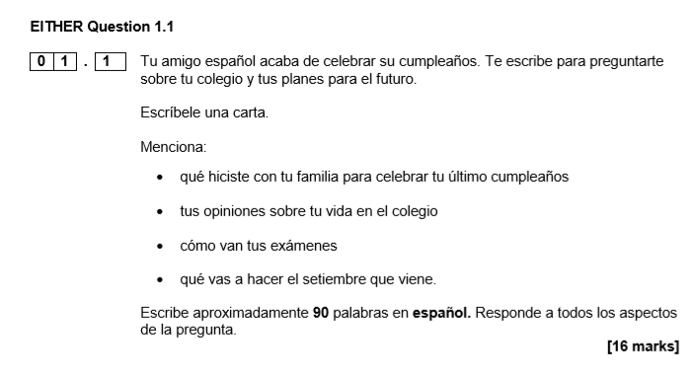

Slide 11
SPEAKING
EXAM
Foundation Tier
Speak for 7-9 minutes with 12 minutes preparation time.
Roleplay
Photo card
General conversation – Conversation on 2 themes which you choose one of them. The other theme is which ever theme has not been covered in the photo card.
Higher Tier
Speak for 10-12 minutes with 12 minutes preparation time.
Roleplay
Photo card
General conversation - Conversation on 2 themes which you choose one of them. The other theme is which ever theme has not been covered in the photo card.
Notes:
Talk about the GCSE Convo paragraphs they have been writing.

Slide 12

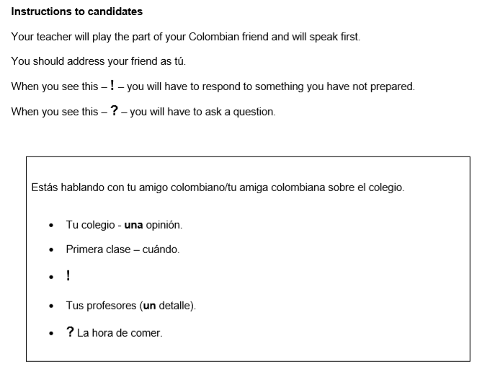

Slide 13
Revision resources
PLUS
Your books, your vocabulary booklets and your conversation answers.

Slide 14
How to revise.
Attend the weekly revision session which is put on by your teacher.
Spanish – Thursday after-school for 1 hour.
German - Monday after-school for 1 hour.
French – Appointments at break and lunch times and after after-school on Thursday.
Attend the Easter revision session which is put on by your teacher.
Spanish – Wednesday 24th April 9am-1pm.
French – Wednesday 24th April 10am-2pm
Not everyone learns the same way so try a VARIETY of methods and use a VARIETY of resources.
Look at the resource list on the hand out and try some of them out.
Use your book, vocabulary booklet and GCSE conversation answers.
Get someone to test you.
Create mind maps, flashcards and verb/ tenses tables.
Record yourself reading out your conversation paragraphs and listen back to them over and over again.
Do past papers – Your teachers can print you one and will happily mark it for you.

