Slide 1

Maths

Slide 2
Three exam papers
Paper | Length | Date / Time
1 (non calculator) | 1hr 30m | Tuesday 21st May – 9am
2 (calculator) |  | Thursday 6th June – 9am
3 (calculator) |  | Tuesday 11th June – 9am

Slide 3
Where are we now?
Y11 recently completed their second mock exams
Students use ‘mock analysis’ to write personalised revision list focusing on topics where they lost marks
Teachers will also use this information to write a schedule of lessons leading up the exams

Slide 4
Maths revision at BCS
Higher | Foundation
GCSE support Every Wednesday lunchtime in A9
Mondays after school A5 | Tuesdays after school A4
Thursdays after school A9

Slide 5
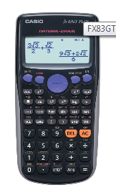
Two-thirds of the exam requires a calculator!
On ParentPay £7.99
We recommend that you purchase this calculator and that all students bring it to every lesson to familiarise themselves with its functions.
Other calculators are allowed, however staff and students are more familiar with this specific calculator if help is needed.
Students often encounter problems during an exam when they purchase it days before the exam.

Slide 6
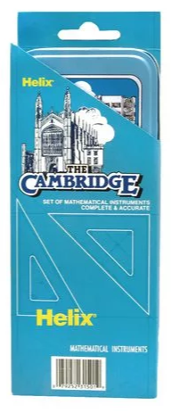
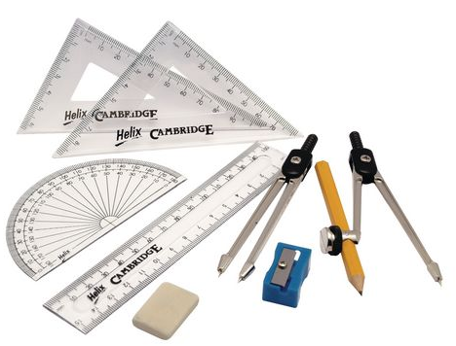
On ParentPay £1.18
Stationery set

Slide 7
Successful maths revision is all practise practise practise
Choose a topic from your priority list to revise and then practise questions on it
No longer than an hour at a time!
Completing past papers will take a little longer but you can break them down into shorter sections

Slide 8
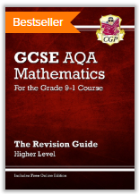
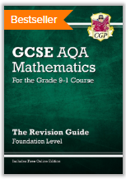
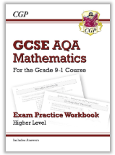
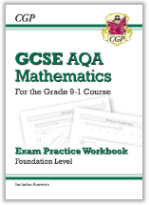
All £2.50
CGP revision guides and workbooks
Revise a topic at a time

Slide 9
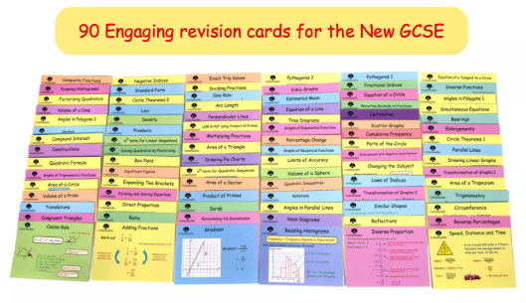
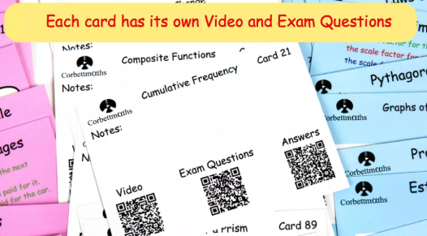
£6.25
CorbettMaths revision cards
Revise a topic at a time
Corbett video

Slide 10
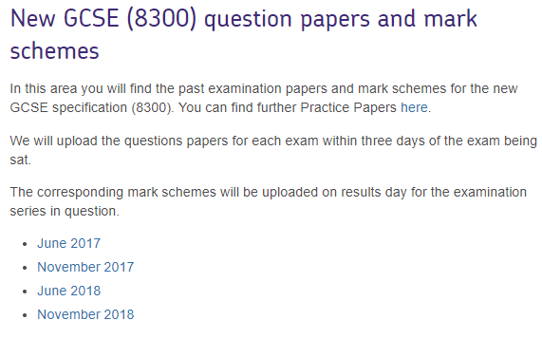
Alongside revising the methods, students must apply what they have learnt….repeatedly!
AQA GCSE Maths

Slide 11
What to expect from the exam papers
80 marks available on each paper
- First 4 questions are multiple choice, another 4 come later on. Never leave blank!
- Approximately 29 questions, can be up to 6 marks for problem solving. So always attempt them and make sure to show your method!

Slide 12
What you can do to support maths revision
Create a schedule of priority revision topics following the mock exam analysis
Test formulae, they need memorising!
Keep attendance up, we’ll be revising different topics each lesson
Paper 1 is non-calculator and we see a lot of numeracy errors, keep testing times-tables and adding/subtracting with negatives
Ask if students are attending revision sessions

Slide 13
Please take a Maths information sheet
Formulae to memorise
Key websites
CorbettMaths
AQA GCSE Maths 8300 past papers
Seneca Learning
My Maths
Available on ParentPay
Revision guides and workbooks
Corbettmaths revision cards
Stationery sets
Scientific calculators

