Slide 1
Philosophy: Revision Strategies
Effective revision strategies for GCSE candidates

Slide 2

Skills in Philosophy
Knowledge (the ‘what’):
Facts, Moral Exemplars, Quotes
AO1: Knowledge
AO2: Analysis
Analysis (the ‘how’):
Evaluation, Inquiry and putting views under scrutiny

Slide 3


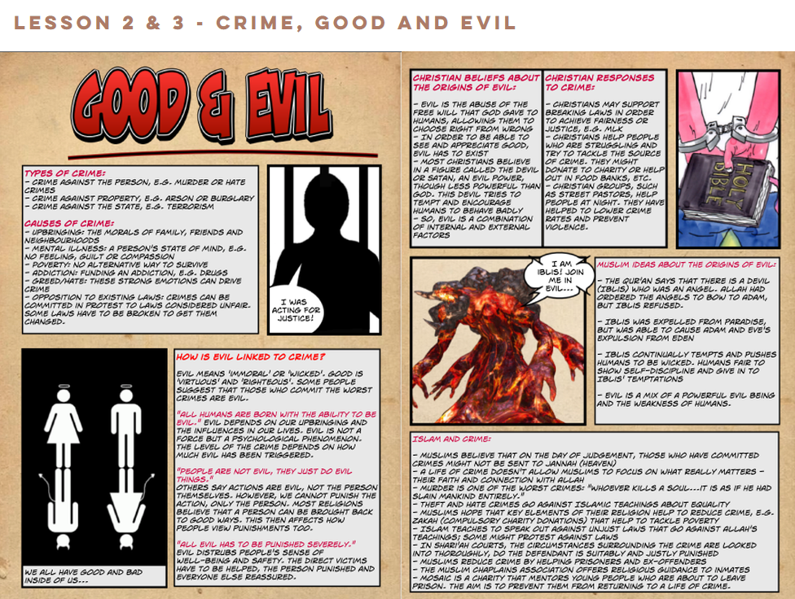
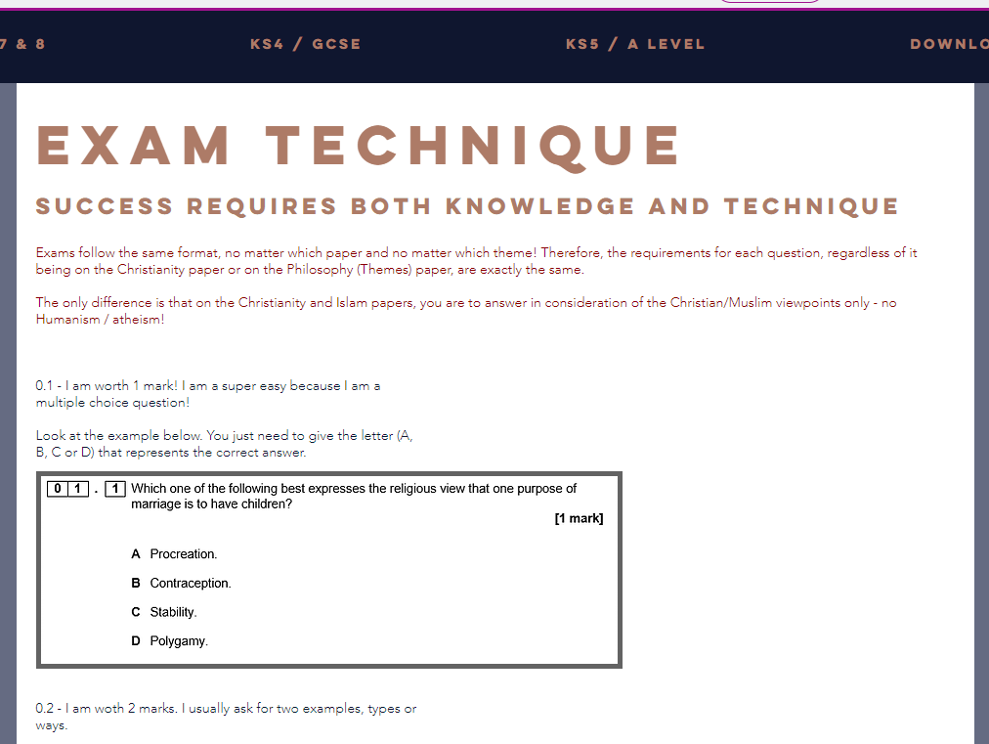
AO1: Knowledge
Website with full course of information, downloads and assessment
Can be used for revision or to access downloadable material to complete at home
Students can view model answers and support with exam technique

Slide 4
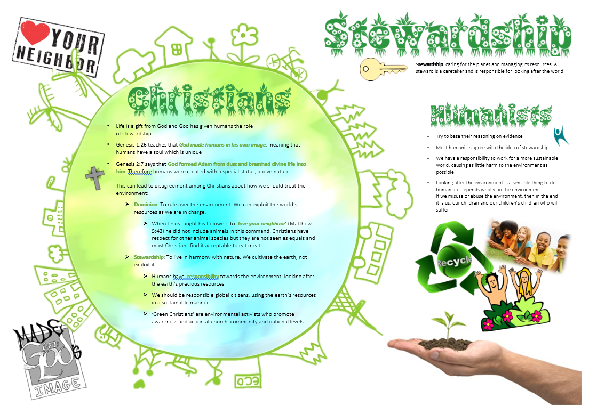
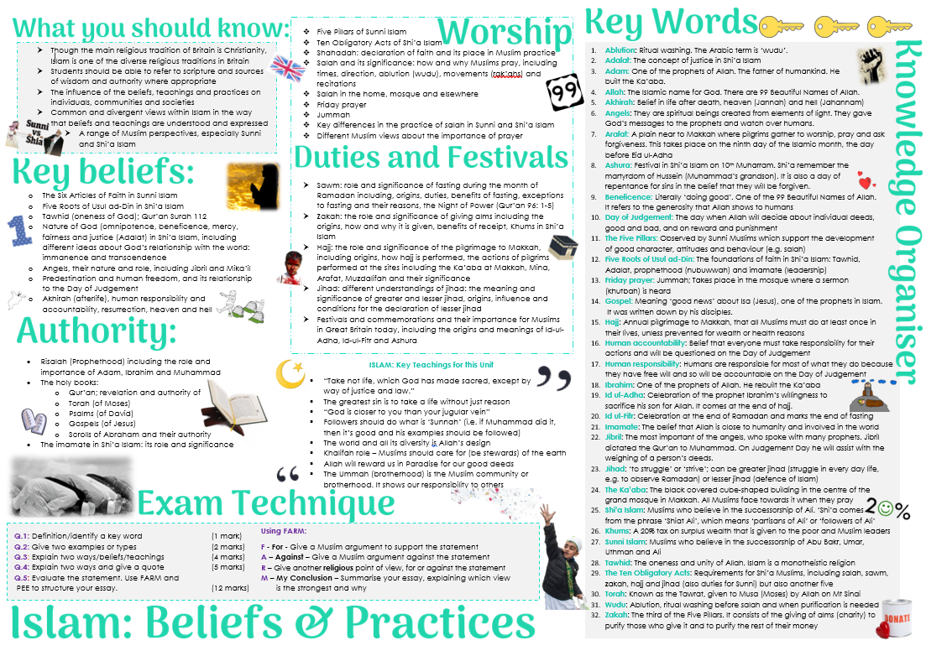
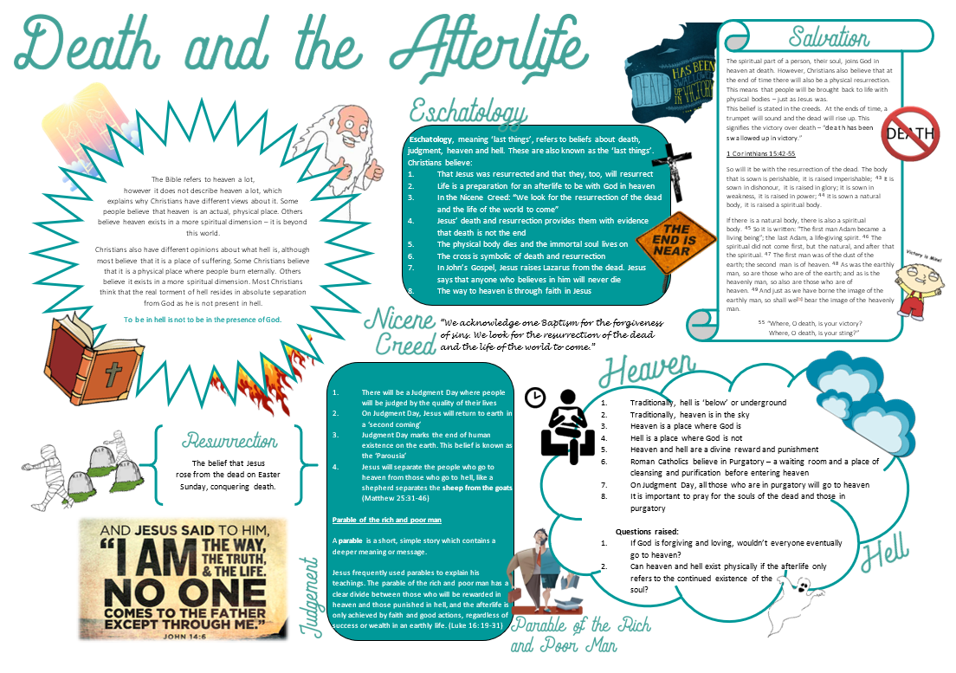
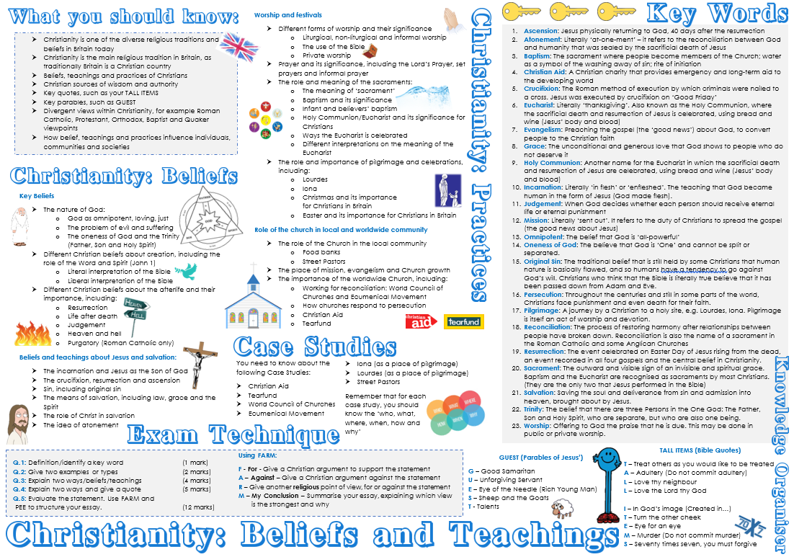
AO1: Knowledge
Knowledge Organisers
Learning Mats
Mind maps
Revision Sheets
Flash Cards
Key Word Card Sorts

Slide 5
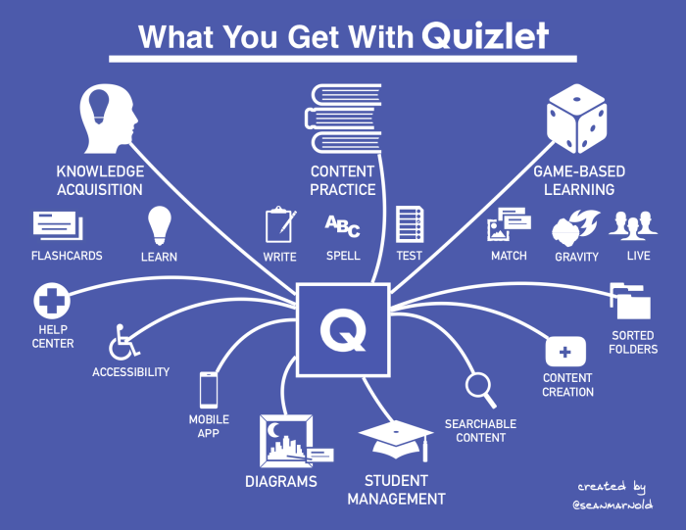
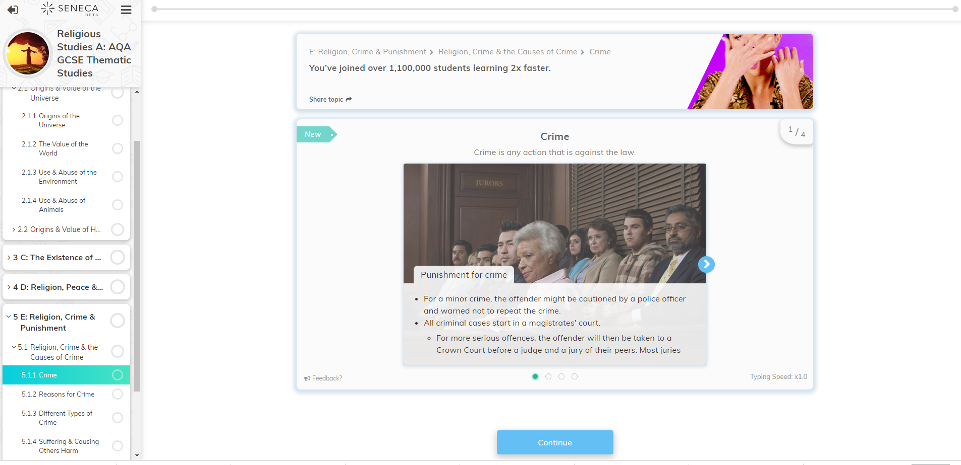


AO1: Knowledge
Revision Apps / Computer-based support
Website (previously mentioned)
Quizlet (make your own flash cards/revision)
Seneca Learning: Class code: kkufk56fbs
BBC Bitesize Website
Nearpod Applications (Ask Miss Carr for code)

Slide 6
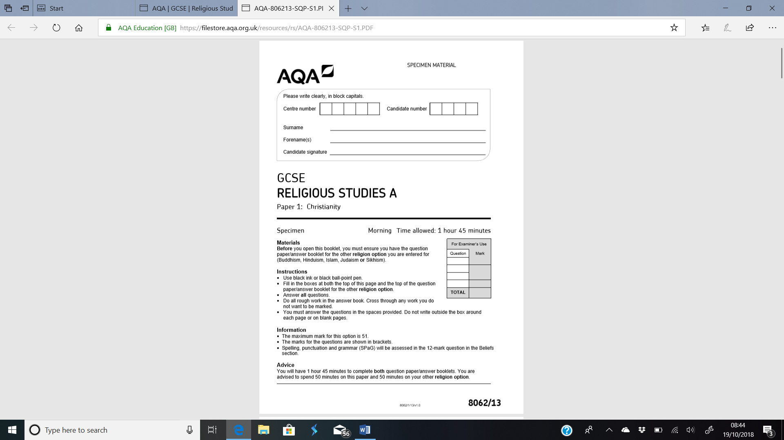
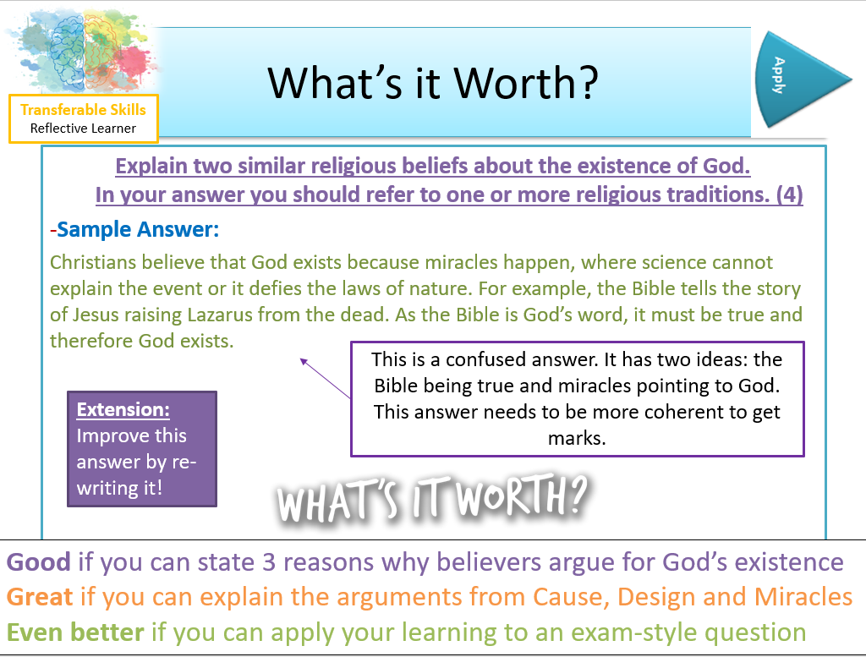
AO1 and AO2: Exam skills
Past exam papers in all topics:
Islam
Christianity
Philosophy & Ethics
Mark schemes or answered papers with model answers available as hard copies and on website
Ongoing revision work in class now focused on exam skills
Exploring worked examples or exam answers, as well as writing their own, helps students process, practice and refine their revision to meet the parameters of exam success.
30 minutes

Slide 7

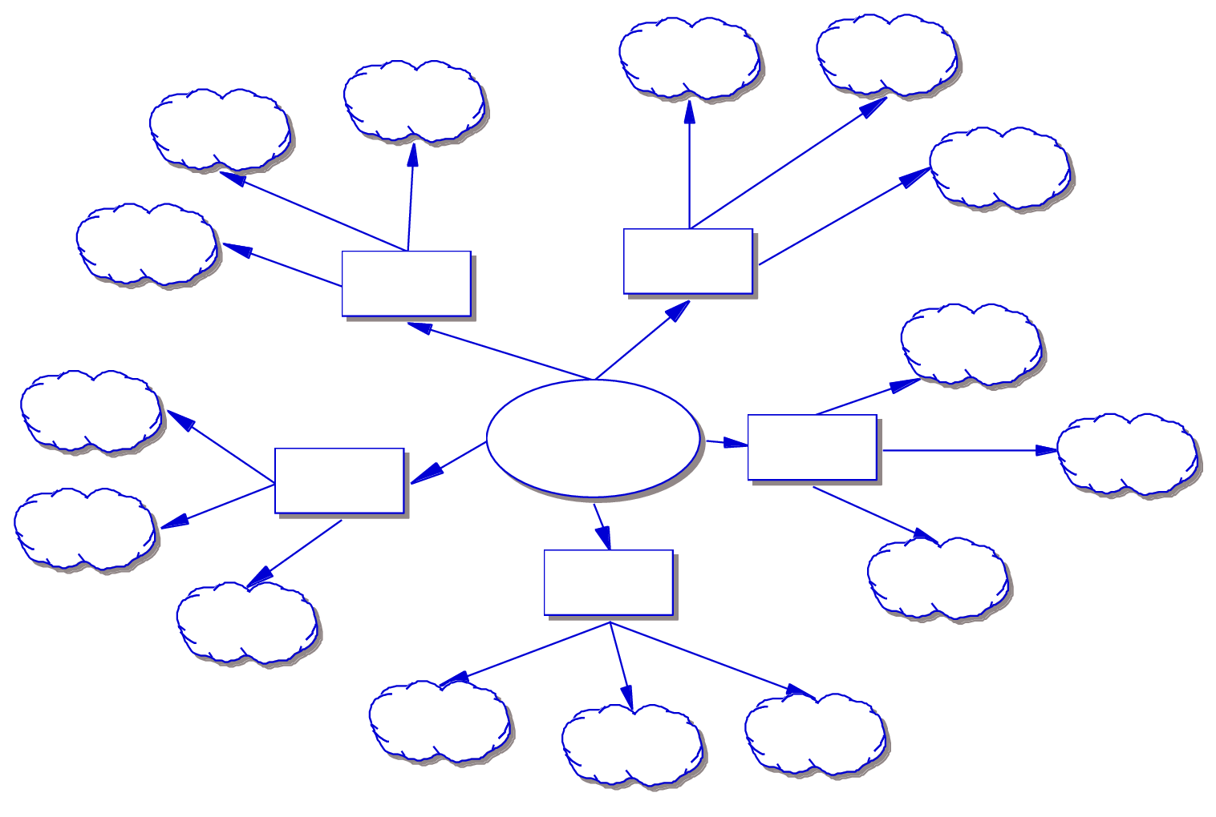
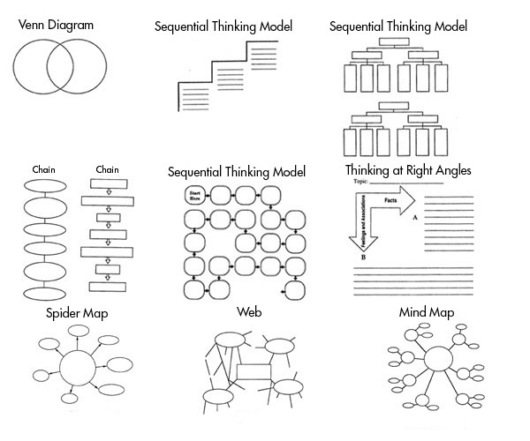
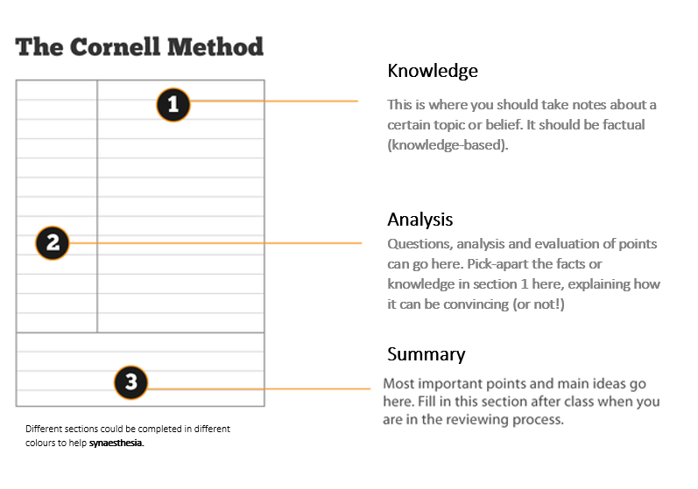
AO2: Analysis
Analysis is a skill that needs to be practised and refined like any other.
Simple ways of analysing include:
Snowballing
Concept maps
Graphic organisers
Cornell note-taking

