Slide 1
Welcome to A-Level Art

Slide 2
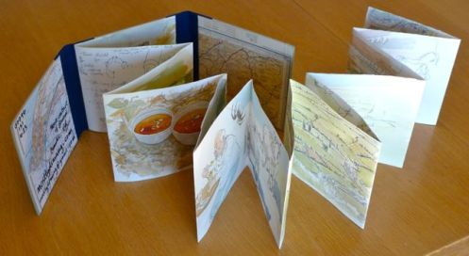
Transition Task
In order to prepare you for A-Level.
I want you to create a concertina sketchbook.
On each page of the sketchbook I want you to draw using one of the media listed on this page.
Choose from one of the following themes to respond to.
Media
Pencil
Fineliner
Ballpoint
Quill & Ink
Watercolour
Oil Paint
Impasto Acrylic
Printing
Coffee
Collage
Fruit & Veg
Everyday Objects
Architectural Features
Use scrap paper, found objects, and other processes to create backgrounds to each page.
On the back of each page, write a basic list of what you did.

Slide 3

Best Universities in the World
Royal College of Art (London)
University of the Arts London
(Including Central St. Martins, Chelsea & Wimbledon)
8. Glasgow School of Art
14. Goldsmiths, University of London
24. Loughborough University
30. University of Oxford
46. UCL University College London
50+ Edinburgh College of Art
50+ Lancaster University
50+ Nottingham Trent Uni
It’s worth thinking about your next steps…

Slide 4
Additional Reading
Ways of Seeing – John Berger Amazon £2.99
Teach Yourself Art History – Grant Pooke Amazon £2.80
This is Modern Art – Matthew Collings Amazon £1.49
A World History of Art – Honour and Fleming Amazon £24.87
Art Now (Vol.4) – Hans Werner Holzwarth World of Books £9.99
The Andy Warhol Diaries – Pat Hackett Book Depository £16.99
The Power of Art – Simon Schama BBC iPlayer
The Private Life of a Masterpiece – BBC iPlayer

Slide 5
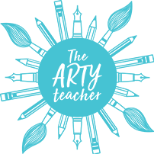


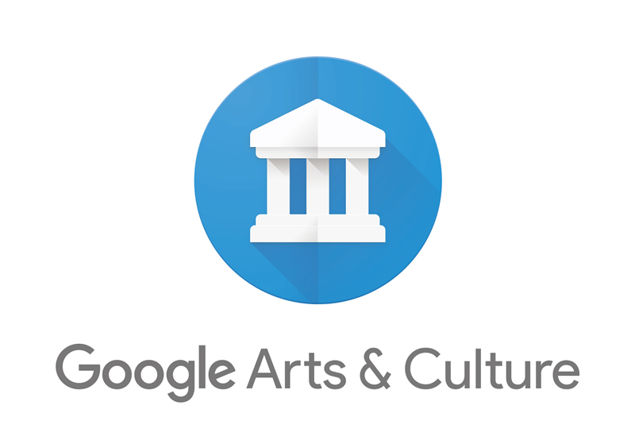
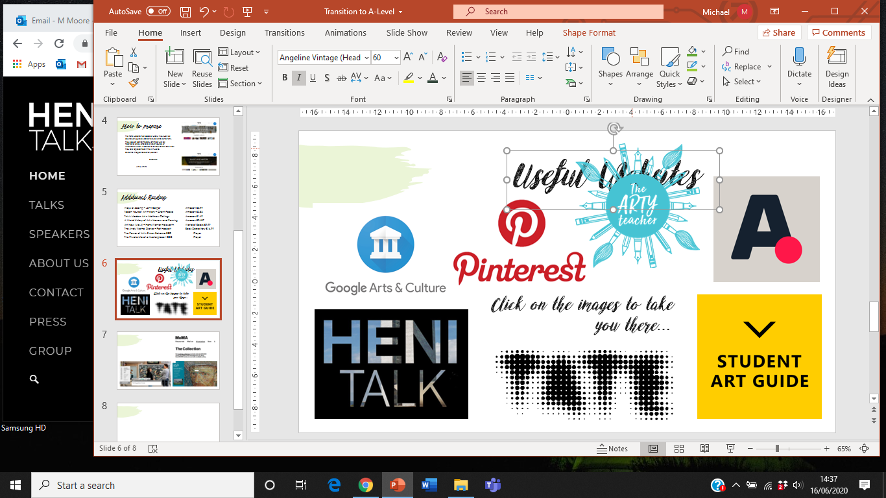
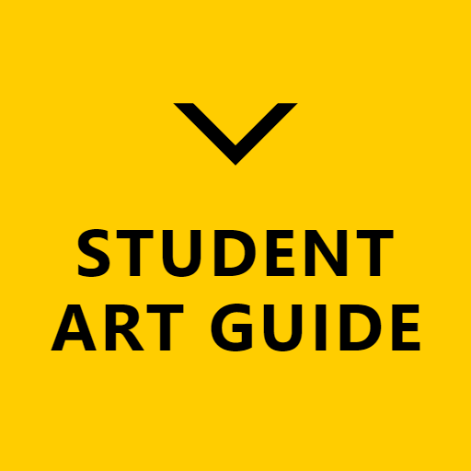
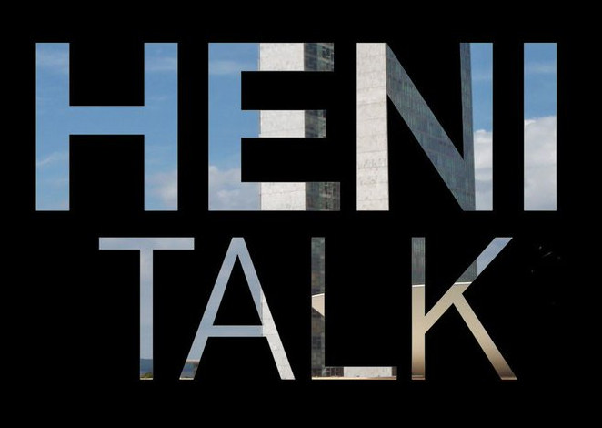

Useful Websites
Click on the images to take you there…

Slide 6
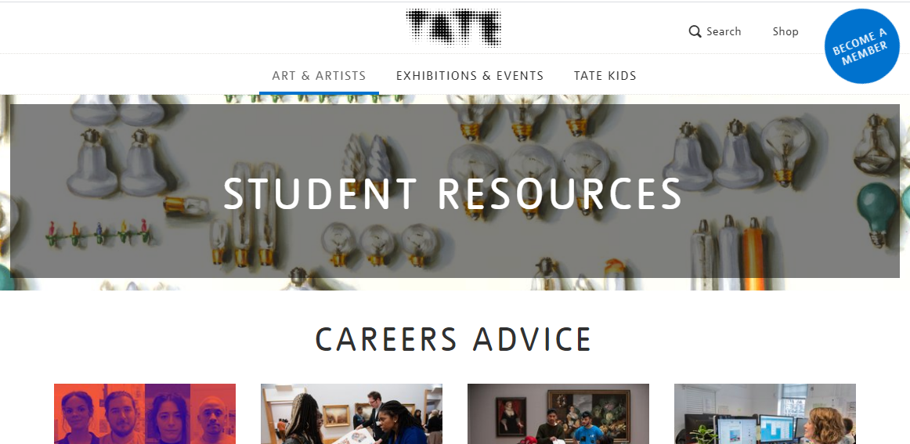

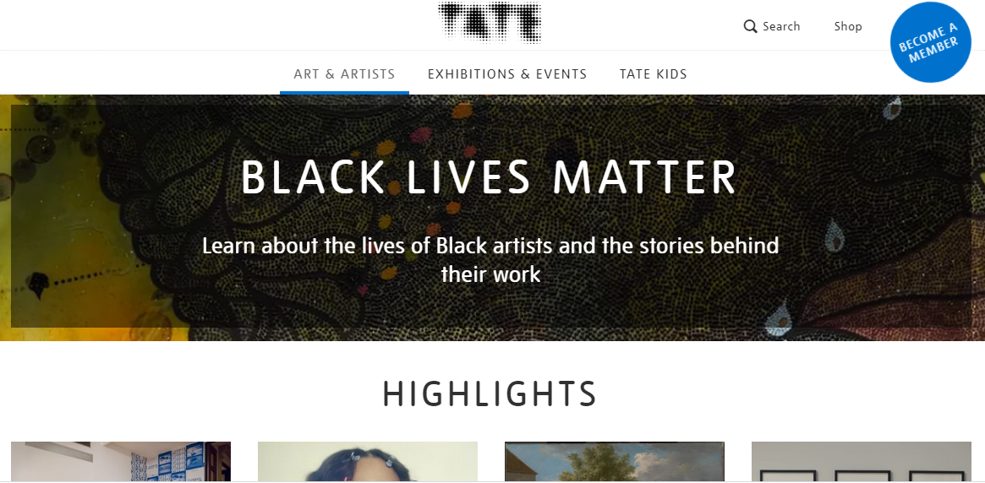

The Tate website has loads of useful links, such as coursework guides, career advice and exhibitions.
They look at contemporary artists as well as traditional ones, and are a great source of information when it comes to current affairs and how they are represented in the Art world.
Click the images to see for yourself.
Students
Art & Artists

Slide 7
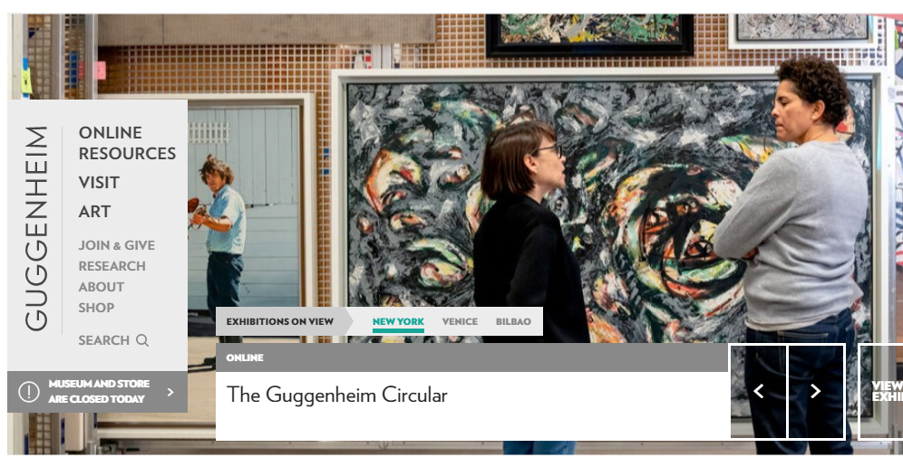
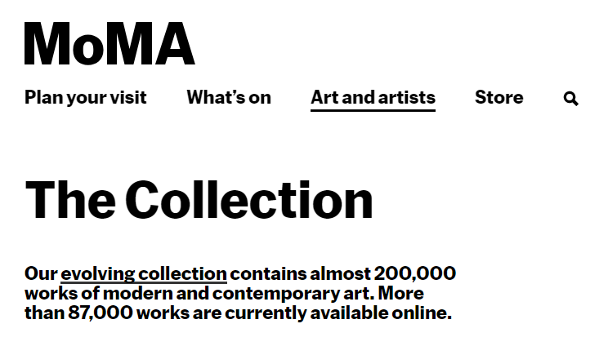
The Guggenheim and The MoMA
The Guggenheim family have for a long time been ambassadors and financial supporters of the Arts. I highly recommend the Peggy Guggenheim in Venice and the Guggenheim Gallery in Bilbao
Here they present their online collection.
The Museum of Modern Art
Might not be everyone’s cup of tea, but it does allow an insight into contemporary views and representation in Art.
This is their online collection.

Slide 8
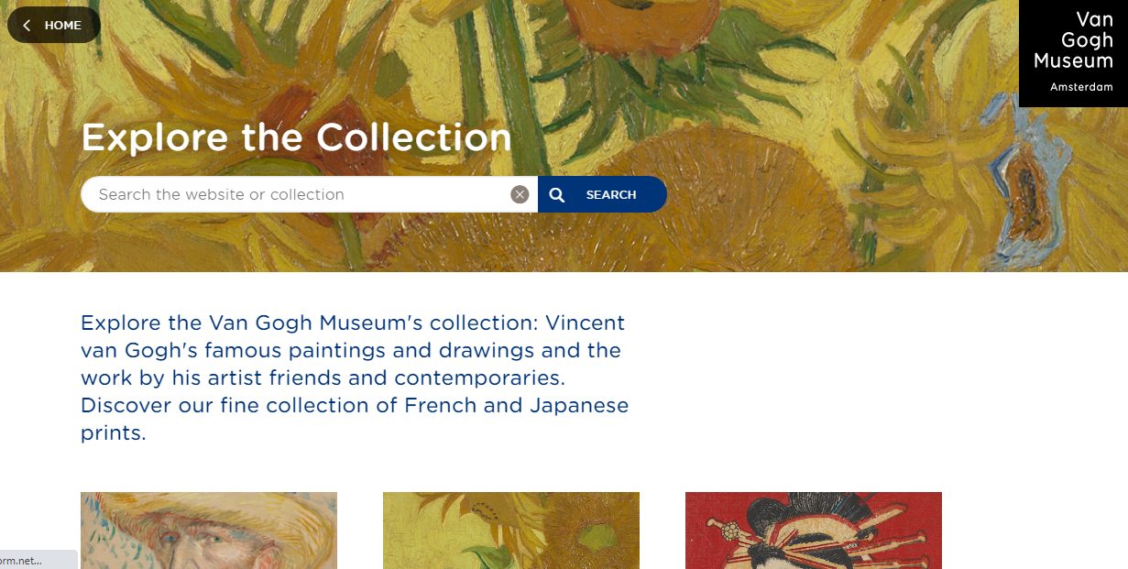
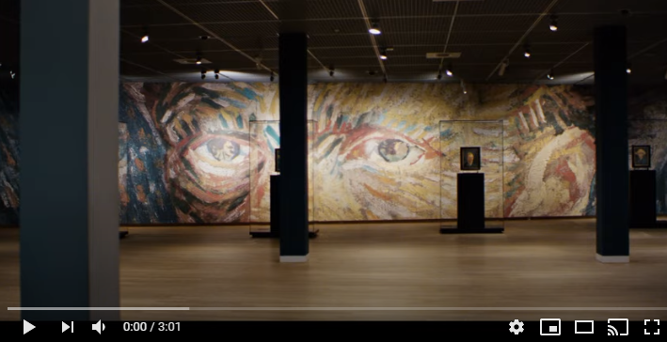
Van Gogh Museum
Considered a forward thinking museum in Amsterdam, worth a visit if you ever go there, however they have made much of Van Gogh’s work available online for you to see.
There are some really interesting discussions on the Google Arts and Culture site based on this, and the video link below will give you a virtual tour…
Saves your carbon footprint..

Slide 9

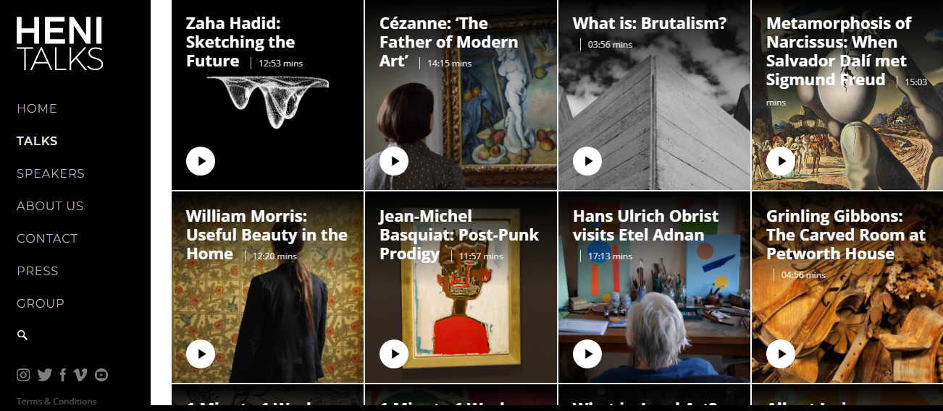
I’ve only recently discovered this site, and I think it’s incredible. It gives you access to short discussions and investigations into Artists and Art movements.
Each “talk” ranges from 3 minutes to 20 minutes, so it’s not a huge effort to take on, but fabulous topics and can be used easily to quote from for your own work.

Slide 10
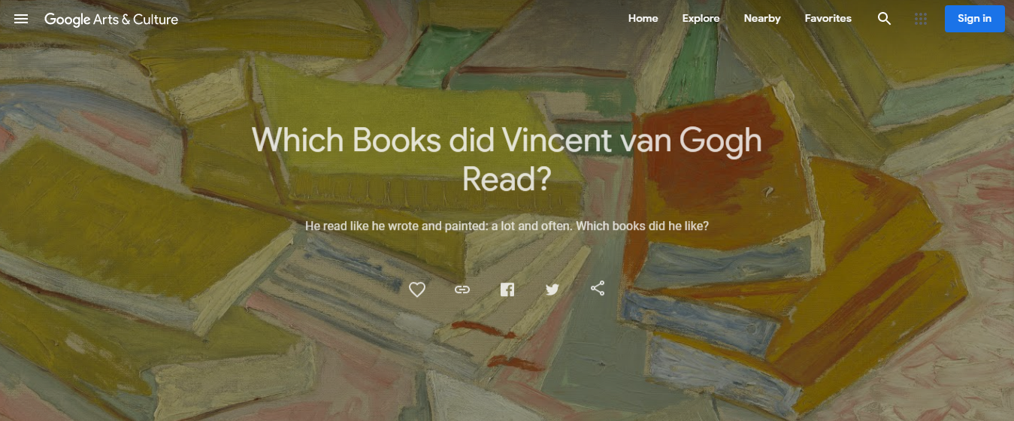
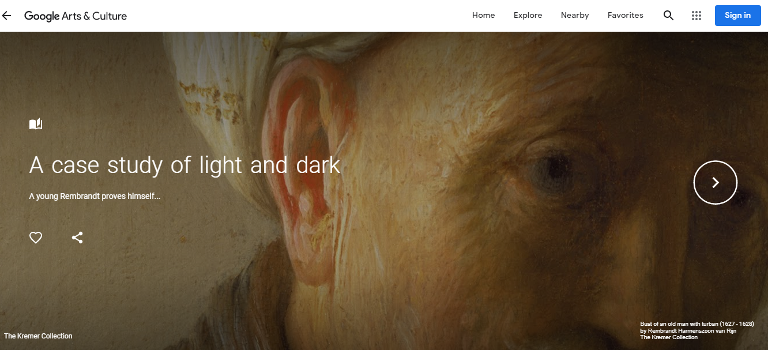
An immense database filled with information, discussions and examples of Artwork.
A pleasing feature in the quality of the sourced images, meaning you can zoom in easily to discover detail.
Take care however, you can get caught and end up on this for hours!

Slide 11
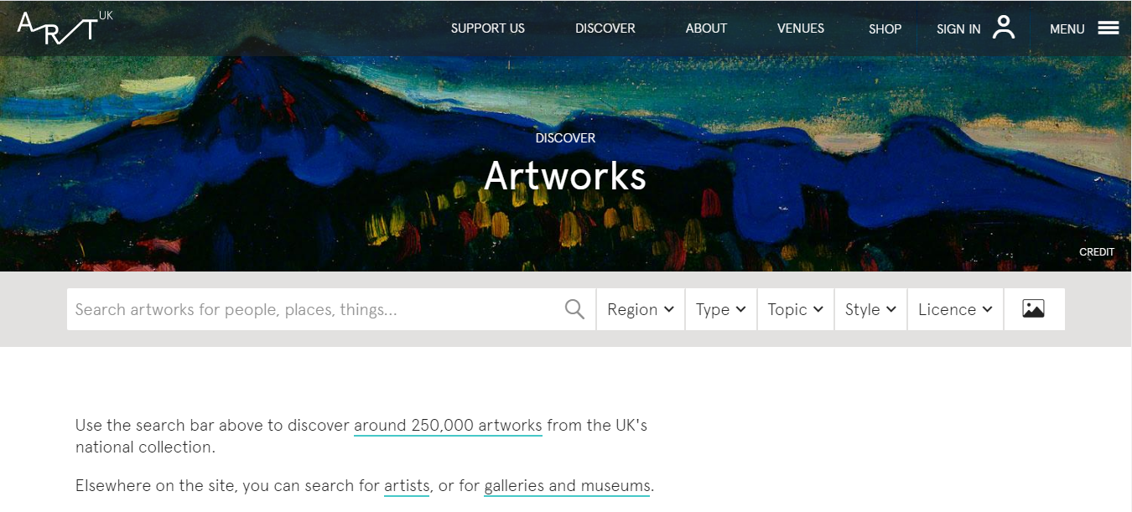
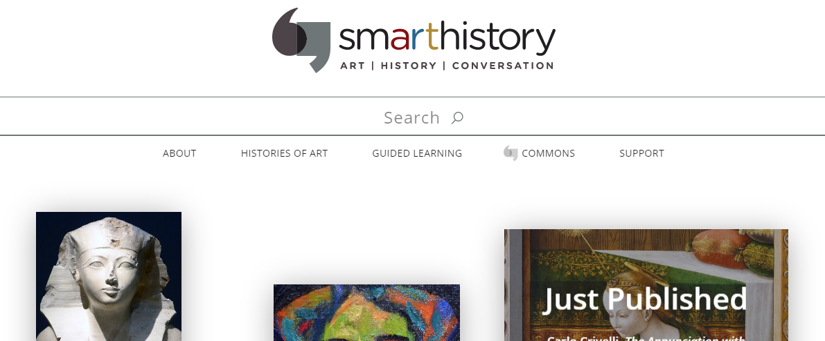
Smart History
ART UK
The home of the UK’s public Art collections.
Virtual gallery of works in a number of UK galleries, I think there are 250,000 in total.
All about Art history, well worth a visit if you’re researching Art movements, Artists, time periods or locations. Filled with videos and essays, excellent for written research.

Slide 12
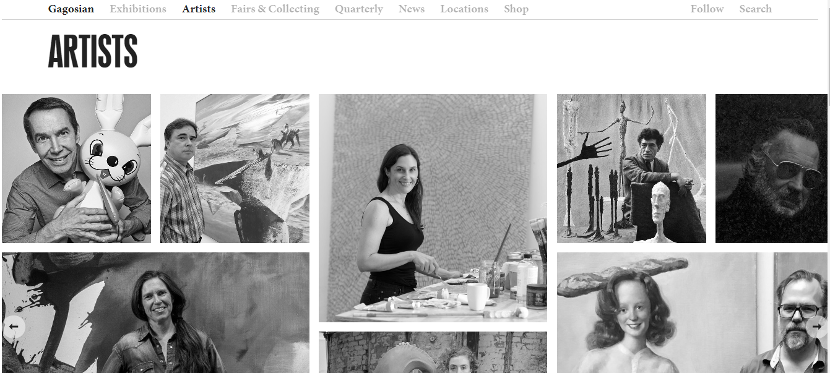
Gagosian
A wonderful collection of Artists for additional research, contains good information and links on a huge number of well known artists.
A good site to have for reference.

