Slide 1



PATHWAYS
Use the arrows to navigate the workbook
NEXT

Slide 2


WELCOME TO FUTURES 2020
This work book has been compiled to help you:
Find out about your options for post-16 study.
Understand the difference between college and sixth form, BTECs and A Levels, apprenticeships and traineeships.
Take part in taster days or virtual tours.
Unravel the language of careers and training.
Recognise your skills and qualities and learn how to develop them.
Explore the variety of careers that you could enter and what it takes to succeed.
Success – what does it mean to you?
BACK
NEXT

Slide 3
PATHWAYS
What do we mean when we talk about pathways? – put simply, the pathway is the route you take to get to your chosen goal. You may choose to go to a sixth form or to college, you might want to become an apprentice or go to university. You may choose to do all of these!!!
For some jobs a degree is mandatory (essential) – for example you cannot become a doctor without studying medicine at university. However, for many other jobs you can choose the training method that suits you best.
But how do you choose which route to take? In the next few slides we will look at the options available to you and how they differ. Remember, there are lots of choices for a reason as we are all individual and have different needs. Think of it like a pair of trainers – you need to find the ones that fit you best and are the most comfortable. They won’t last forever but they need to work for the couple of years you may have them!
BACK
NEXT

Slide 4

Where can I go after my GCSES?
TASK
What are the main differences between sixth form or college?
On a piece of paper try to list as many features/differences that you can.
When you have finished, click on each of the boxes to reveal the answers. Then click next (below) to continue to the next section.
Sixth form
College
Apprenticeship
BACK
NEXT

Slide 5
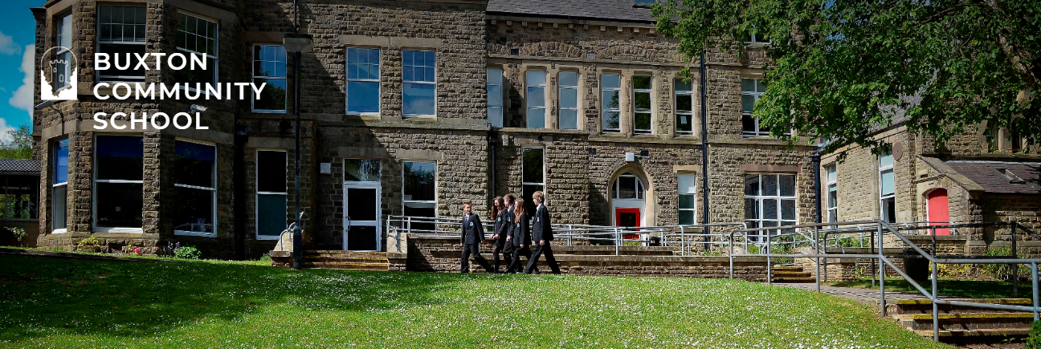
Often in a secondary school building (often where you went to school before).
Lessons take place in a traditional classroom setting.
You don’t usually have to wear uniform (although some sixth forms do).
You will study 3/4 A Levels. Some sixth forms offer BTECs that can be studied alongside A Levels.
You will have a tutor group and registration time (like you do now).
Sixth form lasts for two years.
Assessment is mainly by examination at the end of the two year course. You may have some coursework too.
After A Levels you could go to university, start an apprenticeship, go to college or find employment.
NEXT

Slide 6
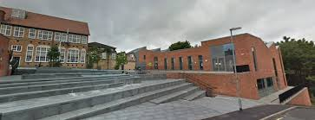
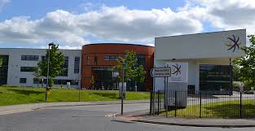
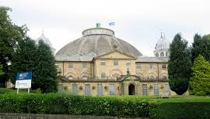
Macclesfield College
Buxton & Leek College – Buxton Campus
Buxton & Leek College – Leek Campus
Will be in a new setting, possibly a different town.
Lessons take place in a mix of classrooms and workplace style settings.
You don’t have to wear uniform – you may need to wear professional overalls.
You will study a vocational course such as NVQ or BTEC. A few colleges offer A Levels as well.
You will not have a tutor group or assemblies and you only have to go in for your timetabled lessons.
Courses last from a few months to a few years.
Assessment is mainly by coursework & practical work. There may be some examinations but not many.
After college you could go to university, start an apprenticeship or find employment.
NEXT

Slide 7

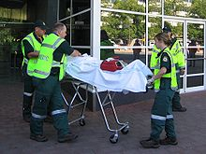
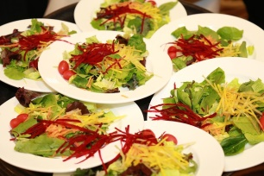
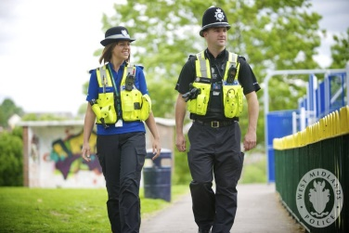




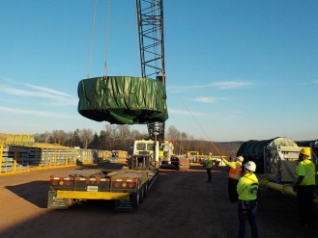
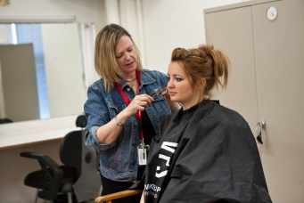



Catering and Hospitality
Education & childcare
Protective Services
Business and Administration
Digital
Health and Science
Care services
Apprenticeships are a combination of employment and training.
There are over 1,500 apprenticeships available from Level 2 – 7.
Usually 80% of your time is spent working and the other 20% learning.
You do not get the school/college holidays.
You will be paid for your work and receive all the benefits of a regular employee.
You are not always guaranteed a job at the end of your apprenticeship.
Apprenticeships are NOT an easy option and due to their popularity it can be very competitive to secure a place with a company.
Sales, marketing & procurement
Agriculture, Environment and Animal Care
Creative & design
Transport & logistics
Hair & beauty
Construction
Engineering & manufacturing
Finance, Legal and Accounting
NEXT

Slide 8
WHAT QUALIFICATIONS CAN I TAKE?
An important factor to consider when choosing where you want to study is what qualification do you want to gain?
Not all establishments offer all qualifications or subjects.
BACK
NEXT

Slide 9
OPTIONS AFTER GCSEs
GCSEs are classed as Level 2 qualifications.
At the age of 16 most students will progress on to complete a Level 3 qualification. Your main options are:
A Levels
BTEC
NVQ
T Levels
If you decide to go to college or do an apprenticeship, you may be required to start your new qualification at a Level 2 before progressing on to the Level 3 – the course providers will discuss this with you at the time of application.
BACK
NEXT

Slide 10
A LEVELS (ADVANCED LEVELS)
These are referred to as academic qualifications meaning they are taught in a traditional academic way (teacher/classroom).
Students select 3 A Levels to study (some students may choose 4).
They are an extension of the subjects that you would have studied previously: maths, English, sciences, art, languages, technology, geography, history, RS etc.
You study your chosen subjects in greater depth than you would have done previously.
A Levels carry UCAS points that can gain you access to university.
BACK
NEXT

Slide 11
BTEC (Business and Technology Education Council)
They are a vocational qualification – they are designed to prepare you for work in a specific field and combine practical learning with study.
You will study one subject area and the final result can be the equivalent of up to 3 A Levels.
Some sixth forms offer BTECs which can be studied alongside A Levels – these BTECs will be the equivalent of studying 1 or 2 A Levels depending on the course on offer.
BTECs carry UCAS points that can gain you entry to many universities.
BACK
NEXT

Slide 12
NVQ (National Vocational Qualification)
NVQs are work based learning qualifications.
They are usually delivered in a work place setting although can also be delivered in schools and colleges.
Courses are designed by and for employers to ensure students develop the specific skills required for their chosen industry.
They do not offer a direct pathway to university as only a small number of NVQs carry UCAS points. An NVQ alone would not be sufficient to apply for a degree course.
BACK
NEXT

Slide 13
T LEVELS (TECHNICAL BASED QUALIFICATIONS)
T Levels are a new qualification being introduced in September 2020.
They have been developed alongside leading employers such as Fujitsu and Skanska.
They combine learning with work experience (at least 45 days are spent in industry).
The qualification carries UCAS points and can gain you access to many universities.
They will be available at a select number of colleges in the North West/East Midlands from September 2021.
Form more information about T Levels click here.
BACK
NEXT

Slide 14
WHICH OPTION IS BEST FOR ME?
You may have a good idea already about where and what you want to study next year.
Others find this decision much more difficult to make – this is more common than you may think so please do not worry if this is you.
You should try to ‘virtually’ visit as many different sixth forms and colleges as you can – look around & chat to staff and current students about the courses on offer.
Talk to your careers advisor, teachers, friends and family about your thoughts and ideas.
Think about what kind of learner you are: do you prefer learning in a classroom environment or do you learn best from a hands-on approach?
How well do you cope with change?
BACK
NEXT

Slide 15
ACTIVITIES TO HELP YOU
What kind of ‘learner’ are you? Are you a ‘hands-on’ type learner or do you prefer reading and listening?
Click here to take a short quiz and find out more.
Learn more about some of the sixth forms and colleges in our local area. Visit their websites by clicking on their names below and make a list of all the positives and negatives. How do they differ from each other and how are they similar? Do you have a favourite?
Buxton Community School Sixth Form
Buxton and Leek College
Macclesfield College
Lady Manners Sixth Form
Cheadle and Marple College
Aquinas College
Fallibroome Academy
To learn more about apprenticeships visit Get My First Job. Here you will find lots of really useful information and you can explore the types of apprenticeships on offer.
Have you ever wondered what it is like inside Buxton and Leek College? Click here to have a ‘virtual tour’ and learn more about their range of courses and facilities.
Can you find any other colleges or sixth forms that offer virtual tours?
To explore a variety of different universities visit the UCAS website by clicking here.
There are lots to choose from!
BACK
NEXT

Slide 16
REMEMBER…
You have many options available to you after your GCSEs.
There is no limit to the number of sixth forms, colleges or apprenticeships that you can apply for. You can make your final decision later in the year.
Deadlines for applications vary – some are as early as 31st October 2020 so do check the information on the institutions’ websites.
Some courses will have stricter entry requirements than others. These are a minimum requirement - you should always aim for the best results you can get to give yourself the greatest chances possible.
Consider your long term plans such as whether or not you may want to go to university or whether there is a specific industry that you are wanting to work in.
BACK
NEXT

Slide 17
AND FINALLY…
Don’t worry if you think you have made the wrong decision.
If you think you have chosen the wrong course, you may be able to change – provided it is early enough in the programme.
Whichever qualification you decide to do should result in you gaining nationally recognised qualifications.
If you do decide to change career at any point in your life you can always retrain.
Whichever pathway you choose, you will gain and develop many transferable skills and qualities that employers look for – regardless of the subject that your qualification is in.
BACK
NEXT

Slide 18
KEY WORDS
UCAS – Universities and Colleges Admissions Service – used by students to apply to British universities.
UCAS Points – Points are awarded to qualifications gained at Level 3 and above. Degree courses require varying amounts of points to be achieved for students to be considered for a place.
Academic – method of study most commonly undertaken in a classroom setting following more traditional school subjects.
Vocational – route of study that is closely linked to a specific industry/career.
Apprenticeship – a combination of employment and training (80/20). Apprentices are employees and therefore do not benefit from school holidays etc. Parents benefits may also be affected when a child becomes an apprentice (see https://www.gov.uk/child-benefit/eligibility)
BACK
END

