Slide 1



APPLICATIONS & INTERVIEWS
Use the arrows to navigate the workbook
NEXT

Slide 2


WELCOME TO FUTURES 2020
This work book has been compiled to help you:
Find out about your options for post-16 study.
Understand the difference between college and sixth form, BTECs and A Levels, apprenticeships and traineeships.
Take part in taster days or virtual tours.
Unravel the language of careers and training.
Recognise your skills and qualities and learn how to develop them.
Explore the variety of careers that you could enter and what it takes to succeed.
Success – what does it mean to you?
BACK
NEXT

Slide 3
NEXT STEPS
We have looked at your options for post-16 studies and learned more about the different types of qualifications you can study for.
Wherever you decide to go and whatever you decide to do, you will need to apply.
Applying for a place on a course or for a job can be a daunting process but it is something that needs to be done.
Application and recruitment processes vary between institutions and businesses but there are some key points that will help you navigate even the most complex of processes.
BACK
NEXT

Slide 4
WHAT WE ARE GOING TO LOOK AT
Application forms and CVs.
Preparing for an interview.
Attending an interview.
BACK
NEXT

Slide 5
APPLICATION FORMS
Application forms are commonly used by many different organisations as the first part of their recruitment process.
They guide the applicant through a series of questions that the recruiter would like answers to.
The majority of the application will be very straight forward and requires simple, factual answers – name, address, employment history, education etc.
There is usually a space near the end where you can write a personal statement explaining why you would like to do the course/apply for the job. These often have strict word counts so it is important that you keep it relevant and concise.
BACK
NEXT

Slide 6
CVs (Curriculum Vitae)
Curriculum Vitae is Latin for ‘course of life’. They are more commonly referred to as CVs.
You may need to send a CV to an employer when applying for a job – although not all employers accept them.
They should detail why you are wanting to apply for the job, your skills and qualities, academic achievements and a bit about you as a person.
They should ideally be no longer than 2 sides of A4.
CVs should be sent to employers with a covering letter (a short letter of introduction).
BACK
NEXT

Slide 7
HINTS AND TIPS
Whether you are completing an application form or writing a CV there are some really important Dos and Don’ts.
Remember – this is the first impression the employer will get of you!
DO
Use correct punctuation & grammar.
Check your spelling.
Make sure the content is applicable.
Back up statements with relevant examples.
Answer all the questions.
DON’T
Use colloquial language.
Make false statements or claims.
Leave any gaps.
Use the same application for every job.
Write about anything negative.
BACK
NEXT

Slide 8
REFERENCES
Whether applying for a place at a sixth form or college or applying for a job, the employer will ask for references.
Referees will give the employer information that will help them assess if you are suitable for the job or course.
They will confirm your skills and abilities.
They can also provide information such as attendance and behaviour.
It is polite to ask a person if they will provide a reference for you before you include their details on an application form.
For sixth form/college/university references your Form Tutor will usually act as your referee – attendance and behaviour in school will be taken into account!
A referee cannot say negative things about you but an absence of positive comments can be just as bad!
BACK
NEXT

Slide 9
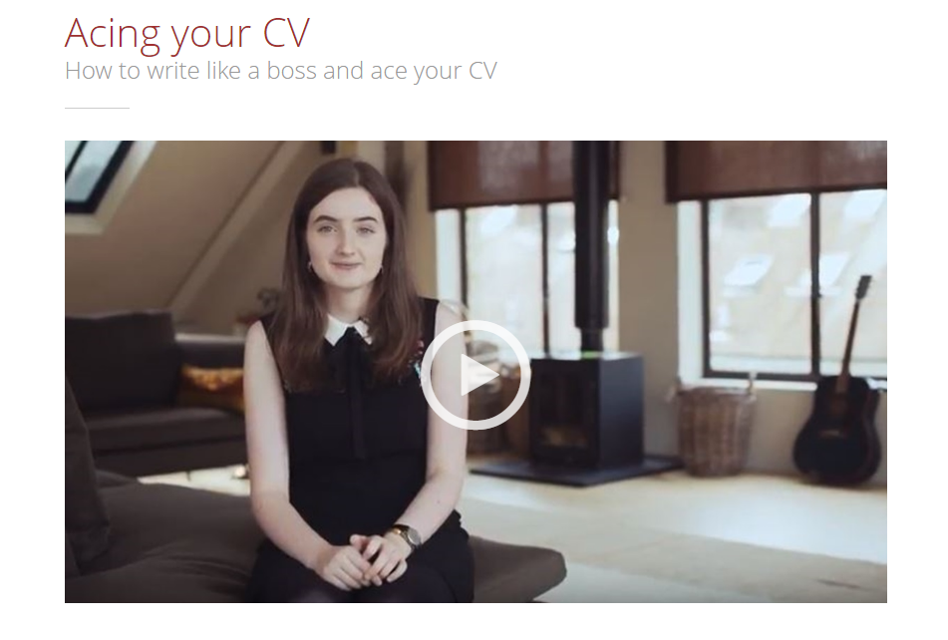
TASK
Click on the picture to watch the clip ‘Acing your CV’ on Unifrog:
Then – using the CV template in Unifrog, have a go at writing your personal statement.
BACK
NEXT

Slide 10
PREPARING FOR AN INTERVIEW
You will receive a letter, email or phone call inviting you to an interview.
Read the information carefully – if anything is unclear or you are not sure of something then contact the company and ask for more details.
It is really important that you are prepared and know what to do for each stage of the interview process – before, during and after.
BACK
NEXT

Slide 11
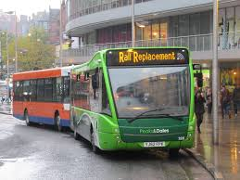

BEFORE THE INTERVIEW
Research the company. Who are they and what do they do? It is surprising how many people being interviewed do not know this information!
Prepare a few questions that you may want to ask – this shows that you are interested in the role and keen to learn more.
Check the location of the interview and the name of the person you will be meeting.
Plan your journey carefully – what time do you need to arrive, are there any planned roadworks/public transport delays that you need to consider?
Decide what to wear – it is important to dress in smart, clean clothes to give a good impression.
BACK
NEXT

Slide 12

THE INTERVIEW
Arrive a few minutes early so you have time to compose yourself.
SMILE – you may be nervous but you want to make a good impression. These may be your future colleagues and friends!
Make eye contact and sit upright in the chair - do not slouch! You want to show the interviewer that you are listening and interested in the conversation.
Take a note pad and pen into the interview. It can be useful to make notes which you can refer to later if needed.
Interviews are a two way process – it is as much about whether they want to employ you as whether you want to work for them. It is OK to ask questions too – most interviewers will encourage this and it is a good way to show your interest in the company.
BACK
NEXT

Slide 13

AFTER
Say thank you and goodbye to the interviewers and, if appropriate, staff on reception.
Take time to reflect on the interview – there will always be questions that you wish you had asked or comments you cringe at the memory of saying!
If you are unsuccessful and do not get offered the job, ask the interviewer for feedback which will help you for future interviews.
REMEMBER – if you do not get offered the job do not be disheartened. Learn from the experience and keep searching!
BACK
NEXT

Slide 14
TASK
Congratulations! You have been invited to an interview at Sainsbury’s in Buxton for the role of check-out assistant.
Your interview is on Wednesday at 9:30am.
You will be interviewed by the Store Manager and will need to ask for them when you report to customer services.
  Plan your journey to the store. How will you get there? What time will you need to start your journey?
  What will you wear to the interview – give your reasons.
  What is the name of the Store Manager?
  What skills/qualities do you think you will need to be successful in this role – can you give examples of how you have demonstrated these in the past. Use PEE (point, evidence, explain!)
  What questions might you want to ask during the interview – try to write 3.
BACK
NEXT

Slide 15

FINALLY…WHAT IS SUCCESS?
On a piece of paper write down your definition of success.
Ask other people in your family to do the same then compare your answers.
Success means different things to different people. It could mean earning a big salary and living in a huge house, or it could simply be being happy and living a stress free life.
You should measure your success against your personal goals – not against other people.
Set yourself a goal but remember it is OK to change your plans if needed – life is unpredictable and we need to be adaptable to change.
BACK
NEXT

Slide 16



FURTHER INFORMATION
For further information and advice on preparing for interviews please use the links below:
Prospects Website – Interview Tips (including access to free practice psychometric tests)
  https://www.prospects.ac.uk/careers-advice/interview-tips
Unifrog Website – How to Interview Like a Boss
  https://www.unifrog.org/know-how/how-to-interview-like-a-boss#:~:text=At%20the%20interview%2C%20keep%20an,them%20through%20before%20you%20answer.
National Careers Service – Interview Advice
  https://nationalcareers.service.gov.uk/get-a-job/interview-advice
BACK
NEXT

Slide 17
KEY WORDS
Post-16 – the period of study after your GCSEs (after you are 16 years old).
CV – curriculum vitae. A written document outlining your skills, qualities and experiences.
Recruiter – person or company looking to hire someone for a role.
Reference – a statement or information about you, written by someone who knows you professionally. Employers or schools may use this information when deciding whether to employ you or offer you a place.
Referee – the person writing the reference.
BACK
END

